Slide 1
LA TOMATINA FESTIVAL
Student : Salvatore Pisfil Vasquez
Teacher : Andres Torres Arevalo

Slide 2
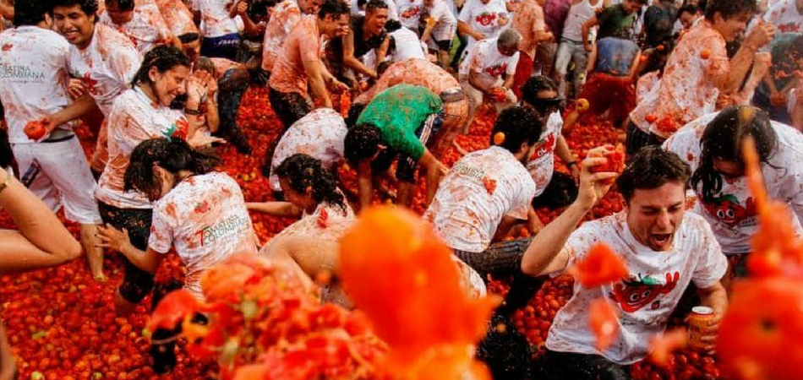
LA TOMATINA FESTIVAL
Today is the last wednesday of August.
This date is important because in Valencia, Spain in the town of Buñol People come from around the world and celebrate.
La Tomatina it is a Tomata fight that lasts for an intense hour.
This festival has become aniconic event full of spirit of unity, fun and joy.
Thay was all teacher, tank you for listening.

