Slide 1
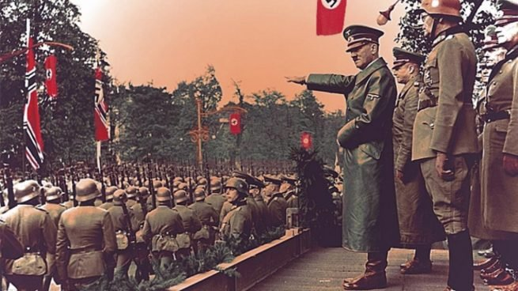
On this Day
Student: Esteban Padilla
Teacher: Chris Lappin
Date: 31/08/22
The Second War World

