Slide 1
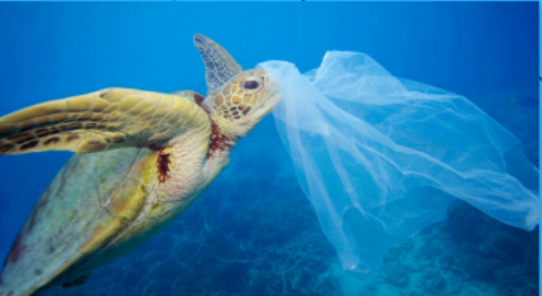
TODAY`S THE PLASTIC BAGS FREE DAY
José Antonio Taypicahuana Valdivia

Slide 2
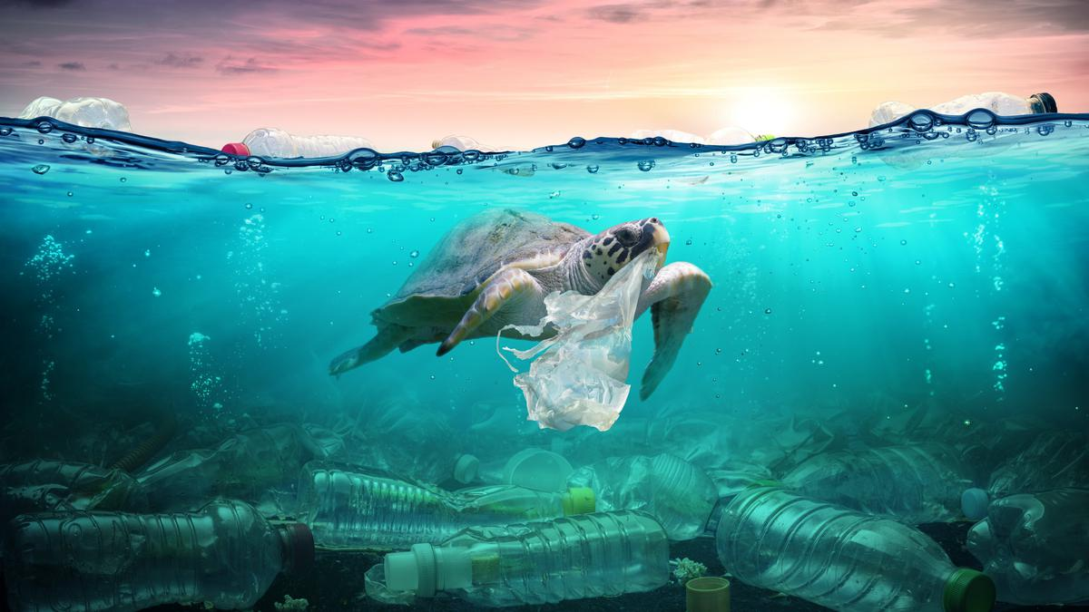
HELP ME BRO
First, A date that seeks to make people aware of the negative impact of their use on the environment because suddenly the plastic bags are the most dangerous predator on the planet but meanwhile people keep polluting more and more.
Finally, most of us want to help the planet because we live on it, but we must help the planet as a partner who needs our help.

