Slide 1
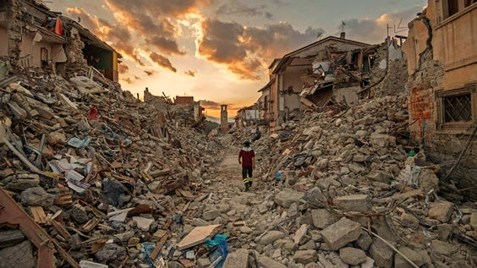
Lima earthquake of 1746
On Friday, October 28, 1746 at 10:30 pm, the inhabitants of Lima were surprised by the violent shaking of the earth that forced them to abandon their homes and look for vacant places. Not everyone could do it and even those who won the street died when the adjacent walls collapsed. Confusion and fear spread throughout the city and made the bewilderment greater.

