Slide 1
Student: Rodrigo Sánchez
Teacher: Chris Lappin
Subject: English
Date: Thursday 13th (thirteenth) October 2022

Slide 3
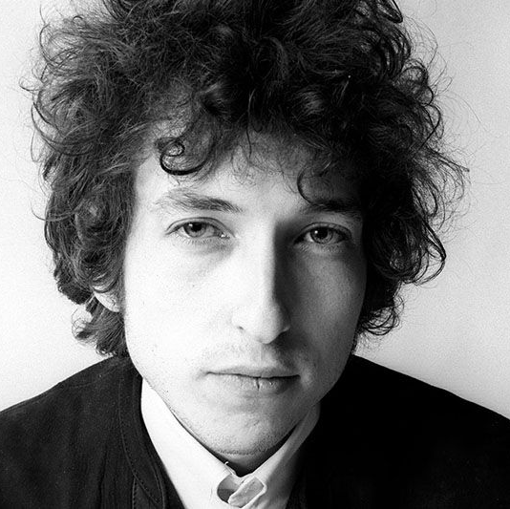
Bob Dylan is awarded of Nobel Prize for Literature
He was awarded with this prize for create new poetic expressions within the great American song tradition.
- Dylan is the 12th Nobel Prize awarded from the United States.

Slide 4
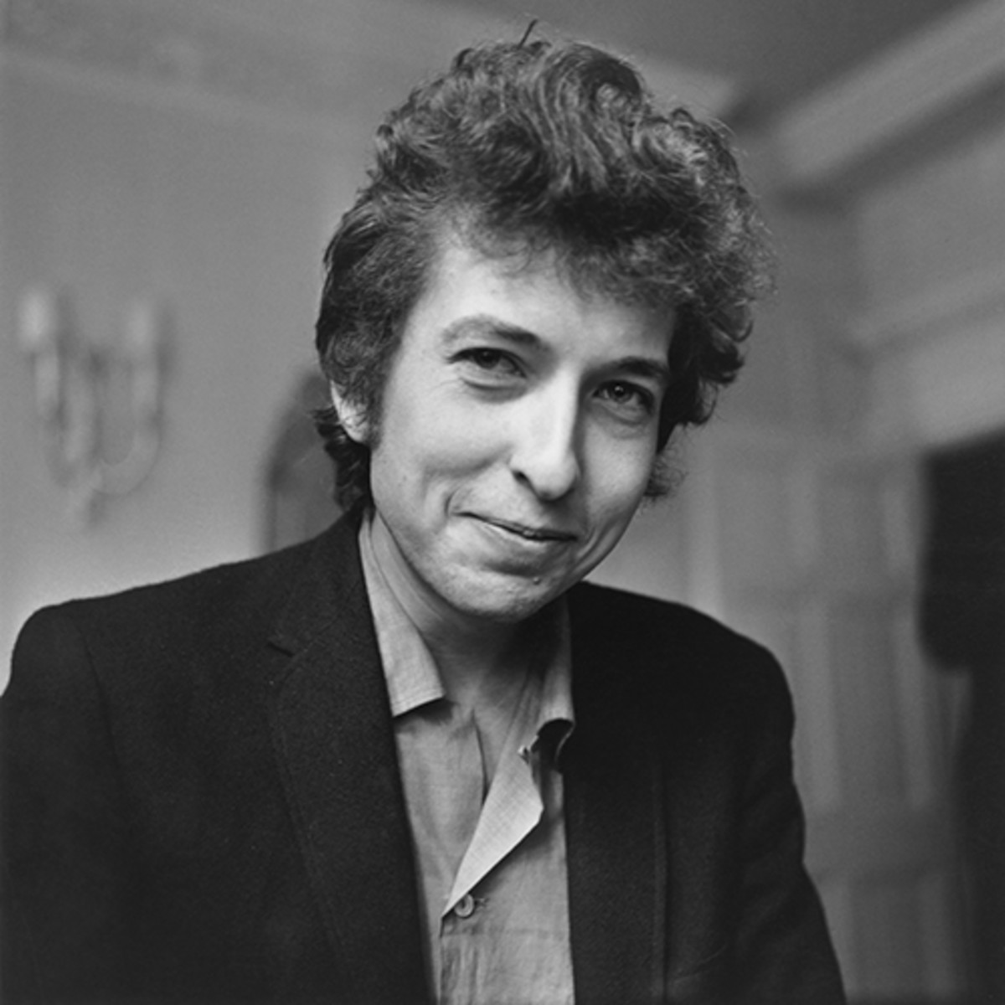
Bob Dylan’s Biography
His real name is Robert Allen Zimmerman.
He was born on May 24, 1941.
Bob Dylan's First Song: "Hey Little Richard" was recorded in 1958.

Slide 5
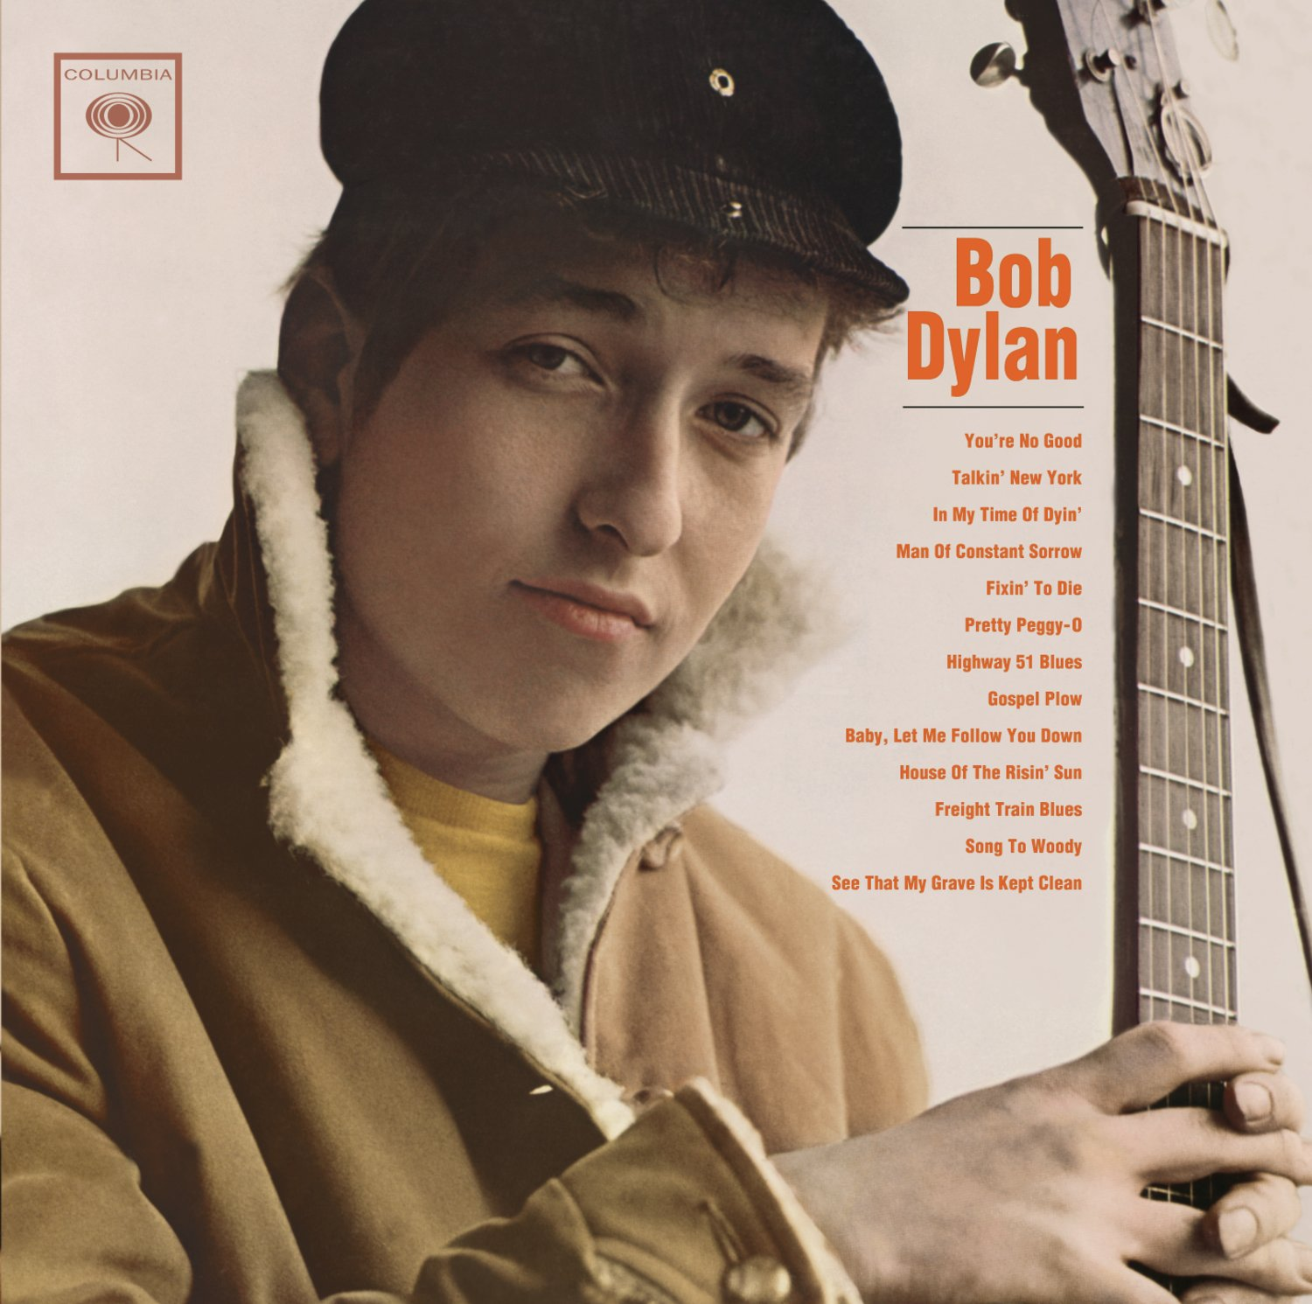
Bob Dylan’s musical career
He started his musical career in 1959.
Bob Dylan was hired by Columbia Records in October 1961.

Slide 6
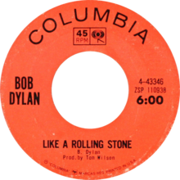
His most popular song: “Like a rolling stone”
Released on July 20, 1965, by Columbia Records.
200 million copies were sold.

