Slide 1
THE SAXOPHONE’S DAY
Student: Oscar Vargas Guerrero
Teacher: Vladimir Solano Gonzales

Slide 2
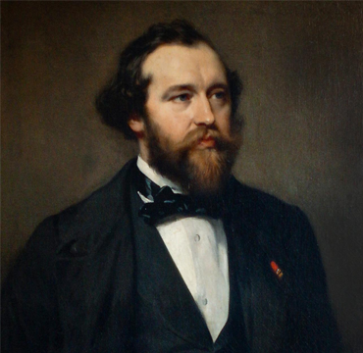
First, I want to mention that the saxophone was created on 6th of November, 1840. Its creator was Antoine Joseph Sax better known as Adolphe Sax.

Slide 3
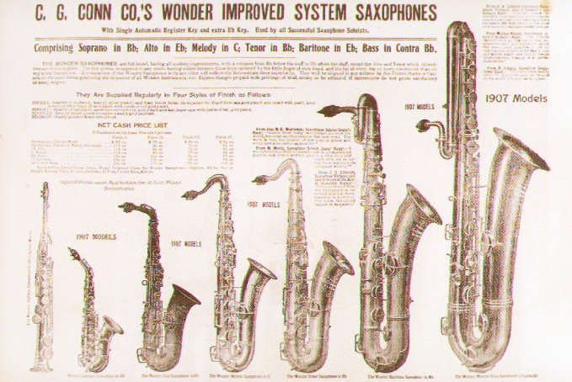
Next, I want to mention the saxophone’s etymology. The word “Saxophone” comes from Adolphe’s last name: “Sax” and the word “phone” that means “sound”.
In addition, I want to talk about the saxophone’s evolution through the years.
A lot of people were based on Adolphe’s design to improve it. This helped people to play this instrument more easily.

Slide 4
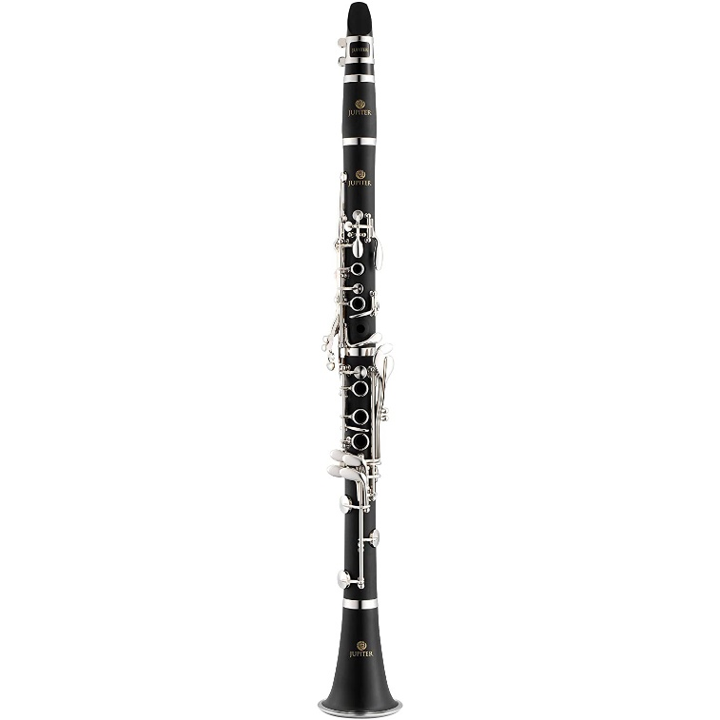
Before finishing, I want to mention a curious fact: Did you know that Adolphe Sax was inspired by the clarinet to create the saxophone?

Slide 5
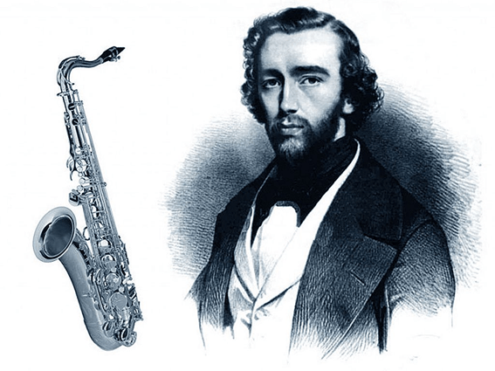
Finally, I want to mention why the saxophone’s day is celebrated. It is celebrated to remmember Adolphe Sax, creator of multiple musical instruments. The saxophone is the most popular.

Slide 6
QUESTIONS
When was the saxophone created?
Who created the saxophone (complete name)?
In what was inspired Adolphe Sax to create the saxophone?

Slide 7
THANK YOU FOR LISTENING!

