Slide 1
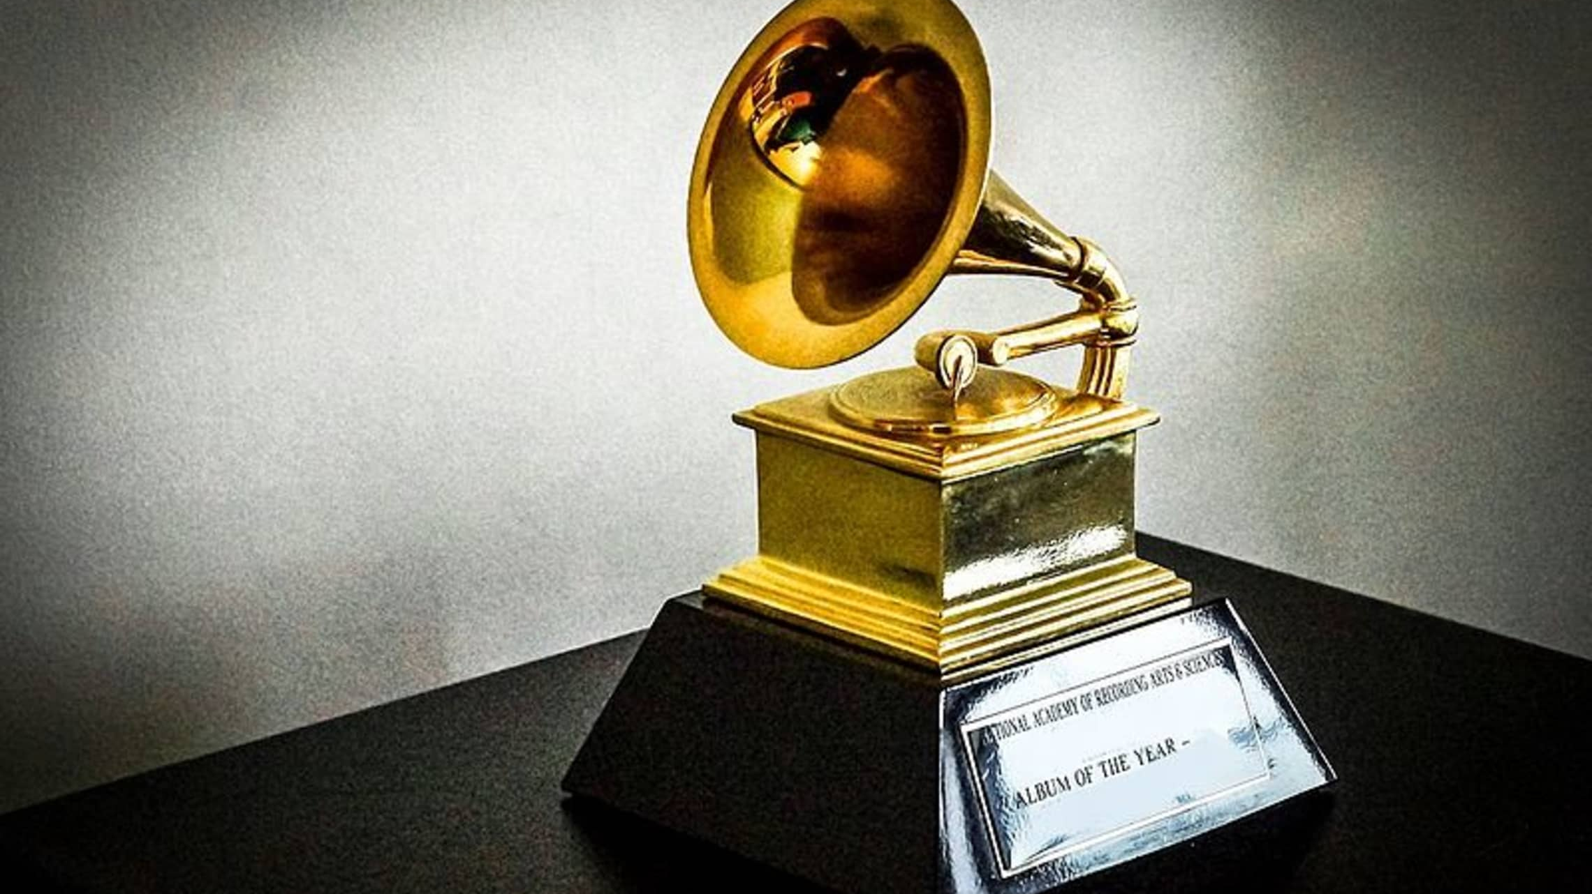
The 1st edition of the Grammy Awards

Slide 2
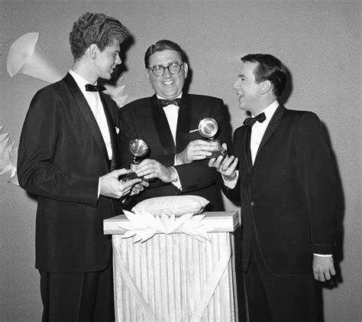
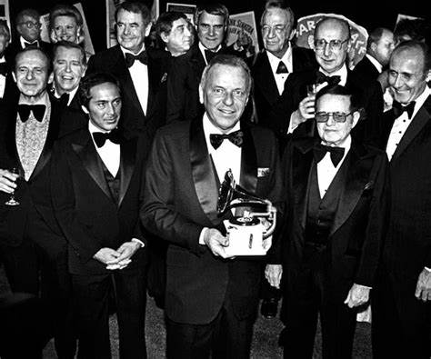
The first edition of the Grammys was in 1959 and at the Beverly Hilton Hotel in the city of Los Angeles and New York. It was created in order to recognize the recording achievements achieved by musical artists during the previous year.

Slide 3
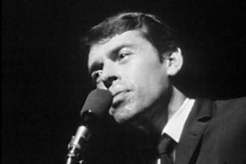
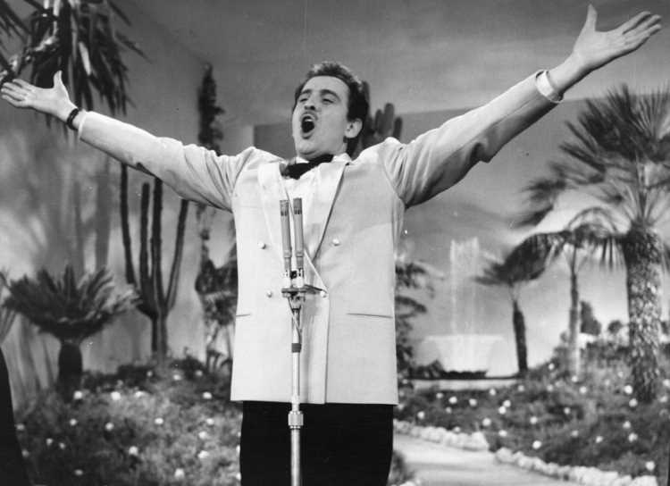
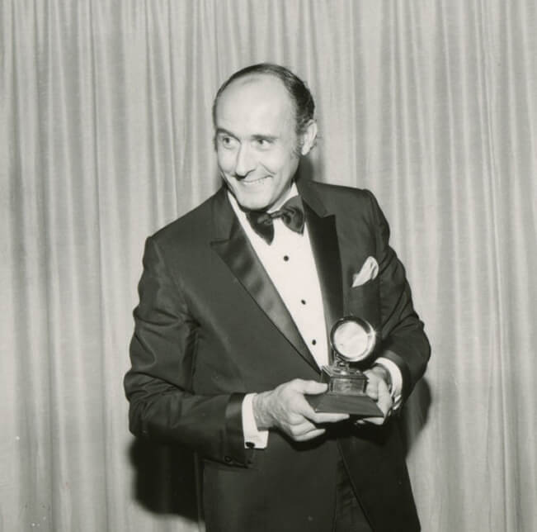
Morth Sahl
The event was hosted by comedian Mort Shal. The winners of this edition were: for record of the year, Domenico Modugno for "Nel blu dipinto di blu (Volare)", for album of the year, Henry Mancini for "The Music from Peter Gunn", and among others.
Domenico Modugno
Henry Mancini

