Slide 1
National Grief Awareness Day
By Fabián Olivos Aguilar​

Slide 2
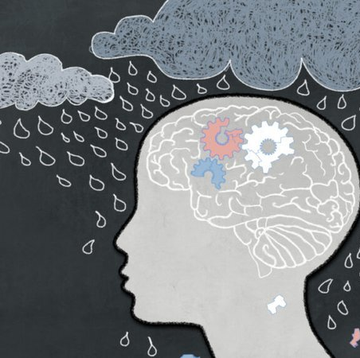
Introduction
This National Grief Awareness Day on August 30.
This date is important because is dedicated to raising awareness of the myriad ways in which individuals cope with loss.

Slide 3
Introduction​
People around the world celebrate this day because offers resources to those going through personal losses and reminds us to support people we know who are grieving.
The founder: National Grief Awareness Day, founded by Angie Cartwright in 2014.

Slide 4
History
Grief is one of the oldest and most enduring aspects of the human experience. If you haven’t yet experienced grief, it’s unfortunately likely to happen.
The term ‘grief’ encompasses all of the emotions around a loss, and ‘mourning’ is defined as the external expression of the pain.

Slide 5
History
‘Bereavement’ is another commonly-used term for grief.
Throughout human history, there have been many attempts to describe and heal grief, and they have changed significantly over the years.

Slide 6
Importance
Spreading awareness on grief to the general public helps to better support those who are grieving and gives those who are not tools for when they encounter grief someday.
It’s essential to support yourself and others while going through a loss.
National Grief Awareness Day can greatly help by connecting mourners to the psychological, emotional, and even financial resources they need to cope with their losses.

Slide 7
That was all teacher, thank you for listening.

