Slide 1
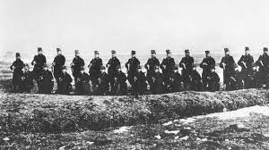




Slide 2
Good Morning Teacher and Classmates Today I will to talk about: “The First Battle Between, Austria-Hungary”, to start Austria and Hungary were allies and France was the rival, but what happened at the starting, the French had assassinated Archduke Franz Ferdinand, to their to Austro-Hungarian crown and his wife Sofia, this caused Hungary and Austria to ally and fight against France, the number of deaths and injuries by France are: 1.4 million deaths and 4.2 million wounded and for Austria-Hungary, the number of dead and wounded were: 1.4 million dead and 3.6 million wounded. To finish, the battle was won by Austria and Hungary.

