Slide 1
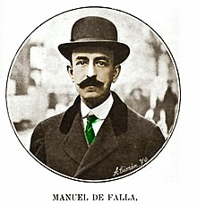
Manuel de falla
Teacher : Vladimir solano
Student : Rafael burgos

Slide 2
Manuel de falla
Manuel de falla y matheu was a spanish composer of musical nationalism , one of the most important of the first half of the 20th century , along with Isaac albeniz , enrique granados , joaquin turina and joaquin Rodrigo , and one of the most important spanish composer of all . The times
His mother was Jose María de Falla Franco
Manuel de falla was born in september of 1876

