Slide 1
On This Day
Student: Esteban Ivan Padilla Valle
Teacher: Chris Lappin Kennedy
Date: 8/11/22

Slide 2
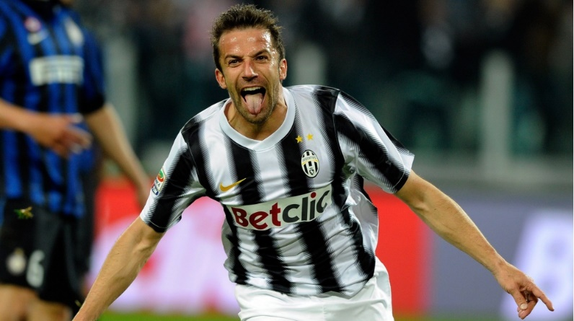
Alessandro del Piero
Born in Conegliano, Italy on November 9, 1974, played as a striker, played from 1990 to 2014, he is one of the legends who has never won a GOLDEN BALL. He played in the Calcio Padova clubs, he passed into the Italian soccer hall of fame, he played 400 games in Serie A, he is the second highest Italian scorer of all time in all competitions, he won certain trophies such as the Golden Foot Award, the Bravo Trophy and the Pallone d'Argento

Slide 3
GOALS and SKILLS

