Slide 1
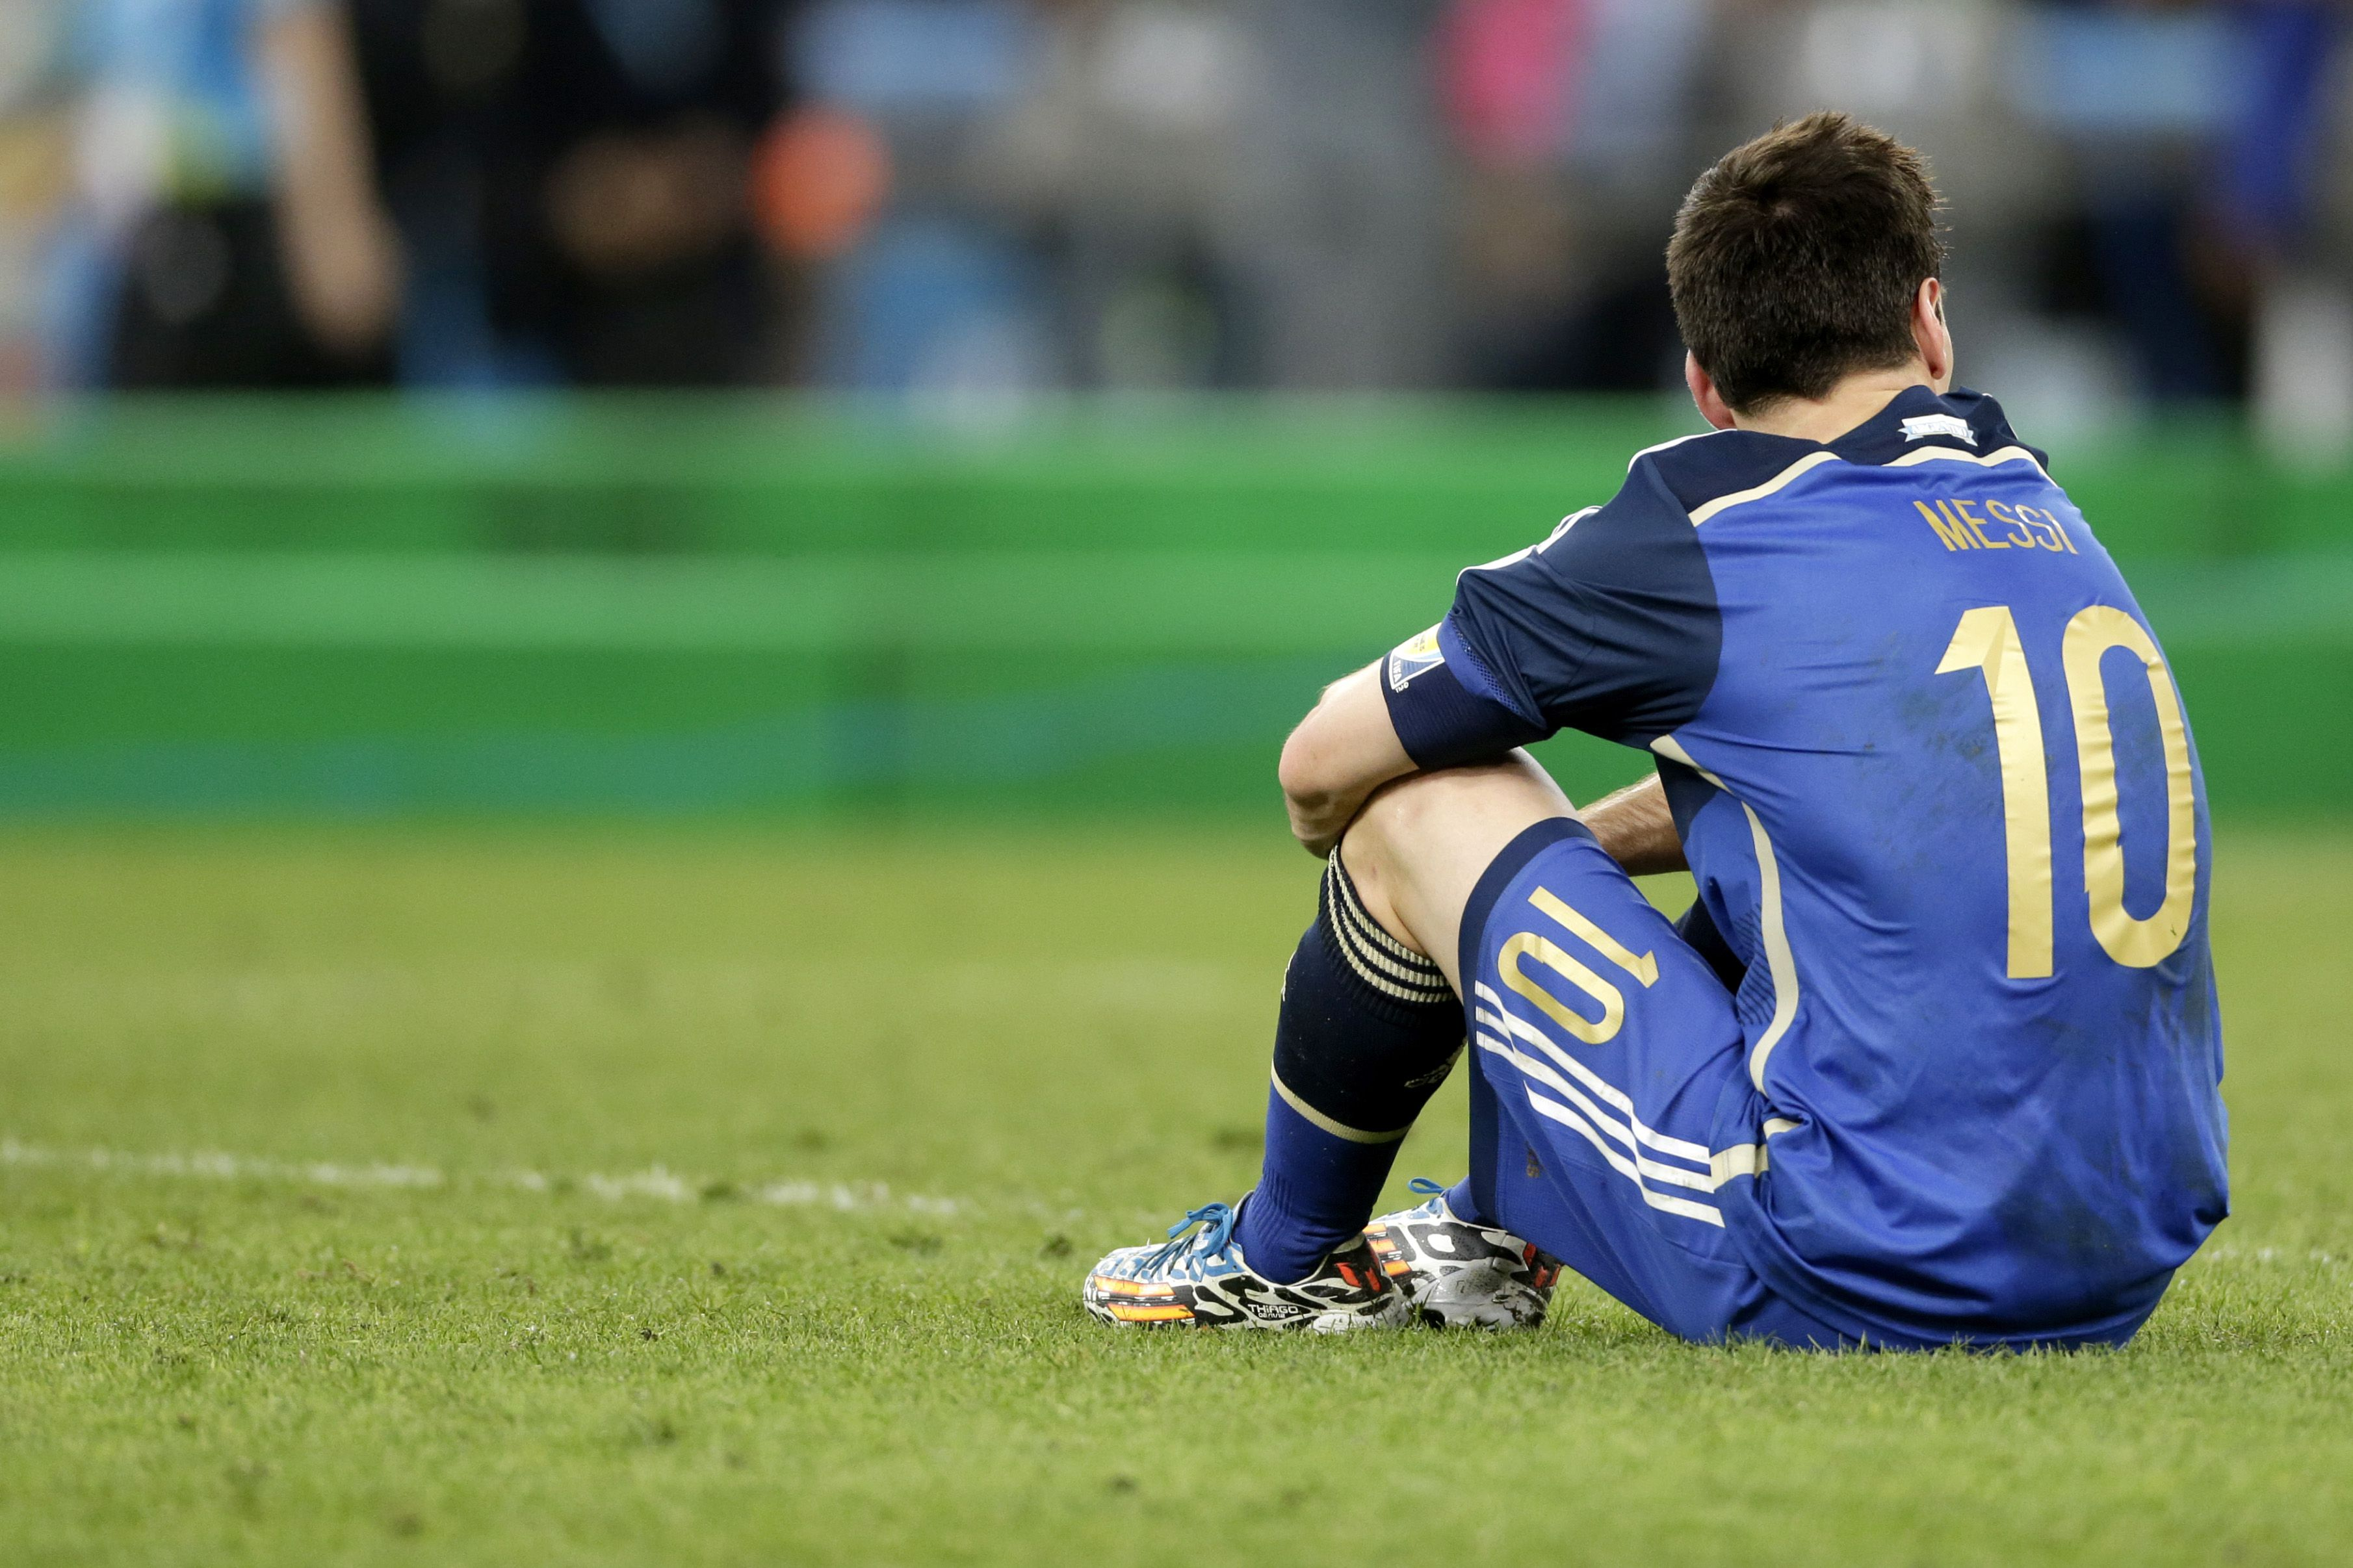
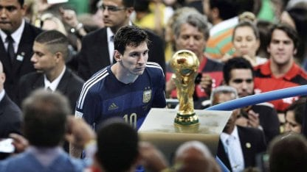
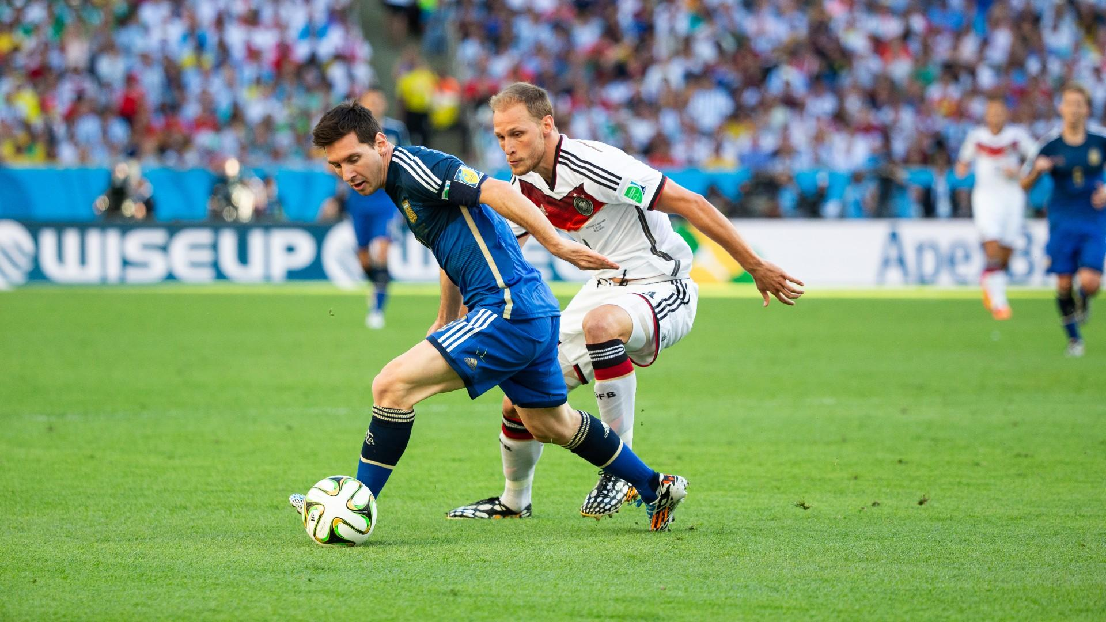
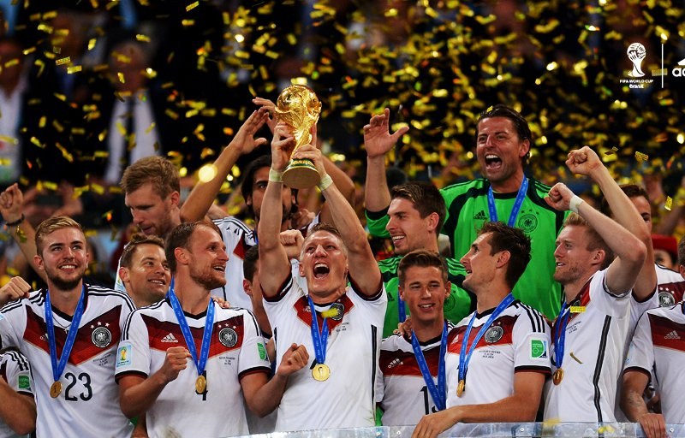
Final of the world cup 2014
Today is the day 13th

Slide 2
Good morning, today I am going to talk about the 2014 World Cup final, which was Argentina vs Germany. First I would like to explain that this final had high expectations as Germany had just beaten Brazil 7-1 and Argentina had some of the best players in the world who had won everything but the World Cup I want to mention in the 56th minute the goalkeeper from Germany He made a clear penalty that the referee did not take, in this final he went to the alarge where in minute 113 Germany would score 1-0 and with that he would win the world cup.

