Slide 1
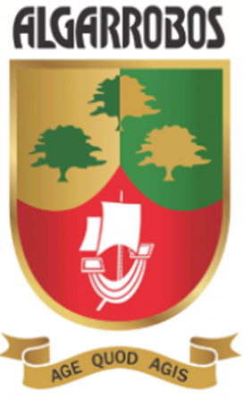
A day like today
October 30th
By Gabriel Pastor Vásquez

Slide 2
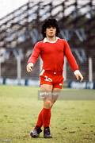
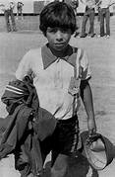
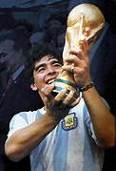
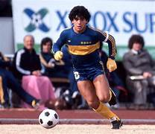
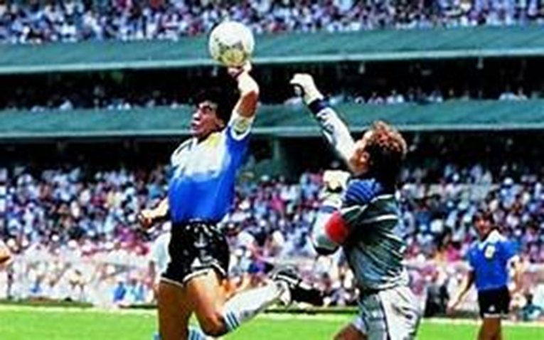
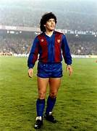
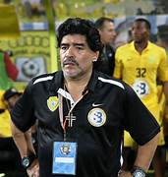
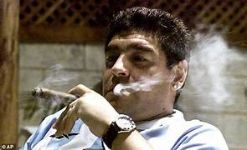
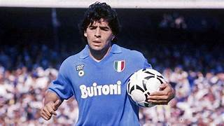

Slide 3
He was born in Lanus, Argentina in October 30th 1960.
With Argentina, he earned 91 cups and scored 34 goals. Maradona played in four FIFA World Cups
His nickname was El Pibe de Oro ("The Golden Boy")
Vision, passing, ball control, and dribbling were some of Maradona’s skills.
In World Cup of 1986 hescored two fantastic goals in the victory over England that entered football history. The first goal was known as the "Hand of God", while the second goal followed a 60 m dribble past five England players, voted "Goal of the Century“.
He became coach in November 2008
For years he was treated for drugs and alcohol abuse. He death with only 60 years.
He played for Argentinos Juniors, Boca Juniors, Barcelona, Napoli, Sevilla, and Newell's Old Boys during his club career.

Slide 4
