Slide 1
Relaciones Métricas
alumno: Oscar joaquin alarcon Quiroz
tutor: Carlos arboleda
curso: geometría
Notes:
© Copyright Showeet.com – Creative & Free PowerPoint and Google Slides Templates

Slide 2
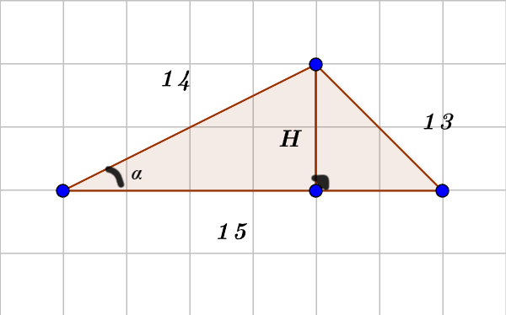
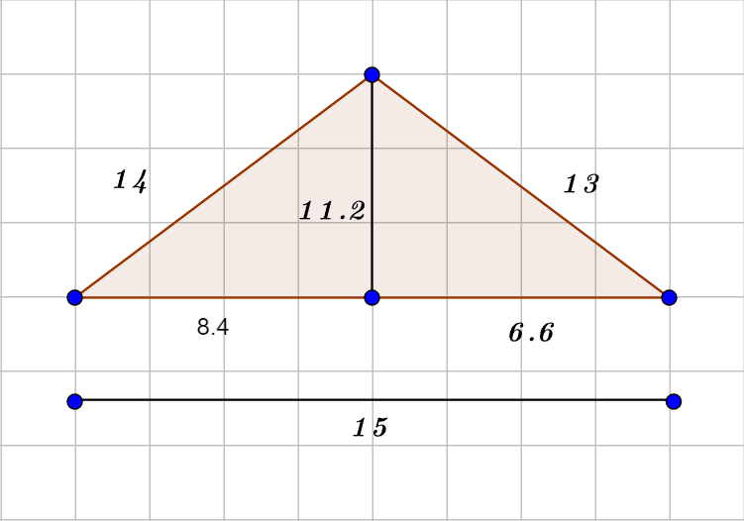
1)Teorema de Euclides
13^2=15^2+14^2-2(15)(a)
169=225+196-30a
30a=252
a =42/5
a =8.4
2)Teorema de Herón
h=$\frac{2}{15}\sqrt{21∗8(21−14)(21−15)}$
h=$\frac{2}{15}\sqrt{21∗8∗7(21−15)}$
h=$\frac{2}{15}\sqrt{168∗7∗6}$
h=$\frac{2}{15}\sqrt{7056}$
h=$\frac{2}{15}$*84
h=$\frac{2∗84}{15}$
h=$\frac{56}{5}$
H=11.2
3)
TG$α=\frac{11,2}{8,4}=\frac{3}{4}$
α=53
Notes:
© Copyright Showeet.com – Creative & Free PowerPoint and Google Slides Templates

Slide 3
Notes:
© Copyright Showeet.com – Creative & Free PowerPoint and Google Slides Templates

