Slide 1
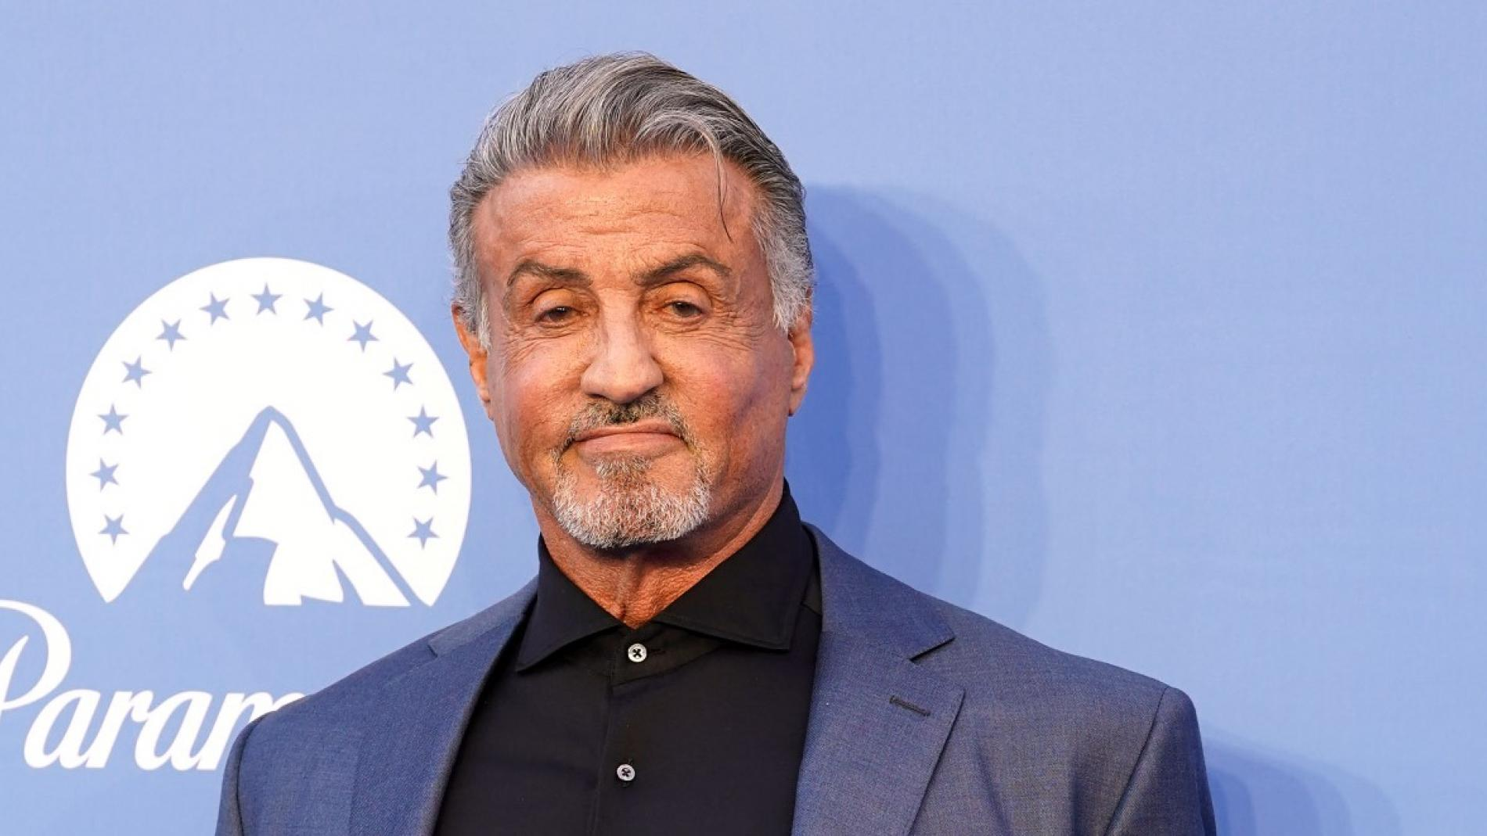
sylvester stallone sylvester stallone sylvester stallone

Slide 2
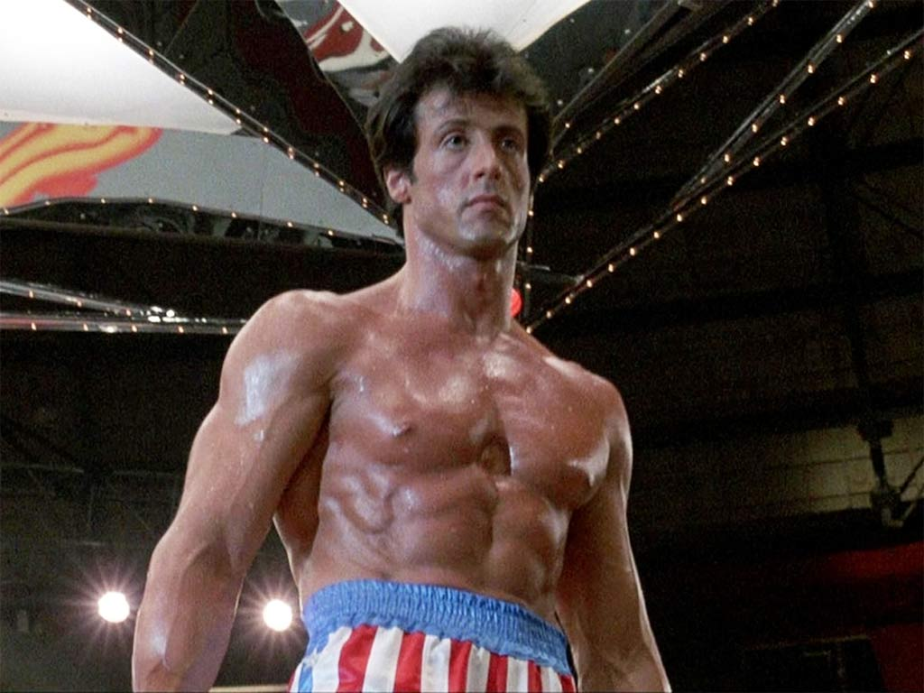
Sylvester Gardenzio Stallone was born on July 6, 1946, New York (USA), the son of Jackie Stallone, Frank.
One of his highest grossing movies was Rocky, in which a boxer from Philadelphia who nobody believes in gets to fight the boxing champion (apollo). raising 225 million dollars. He currently has 5 children, 3 girls with Jenifer Flavin and 2 boys with Sasha Czack - in my opinion he is one of the best actors in action movies like Rambo, Rocky, etc.

