Slide 1
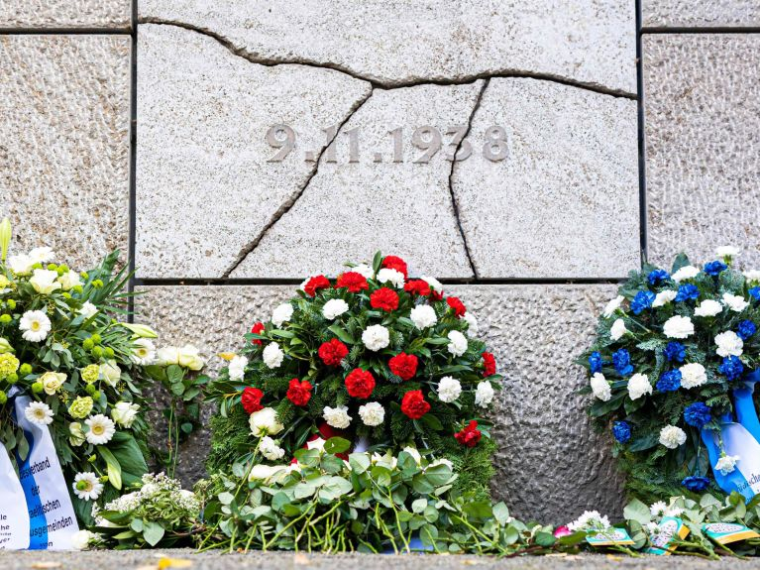
Day of the Fall of the Berlin Wall
José Antonio Taypicahuana Valdivia
Teacher: Vladimir Solano

Slide 2
First, November 9 is a very special date in German history and that is why it is often called the day of destiny of the Germans. Also, November 9 is not a holiday, but a day of commemoration and remembrance. Finally, the commemorative events commemorate each year especially the pogrom of November 9, 1938 against German Jews. But Germany also remembers the Fall of the Berlin Wall in 1989, which paved the way for German reunification.

