Slide 1
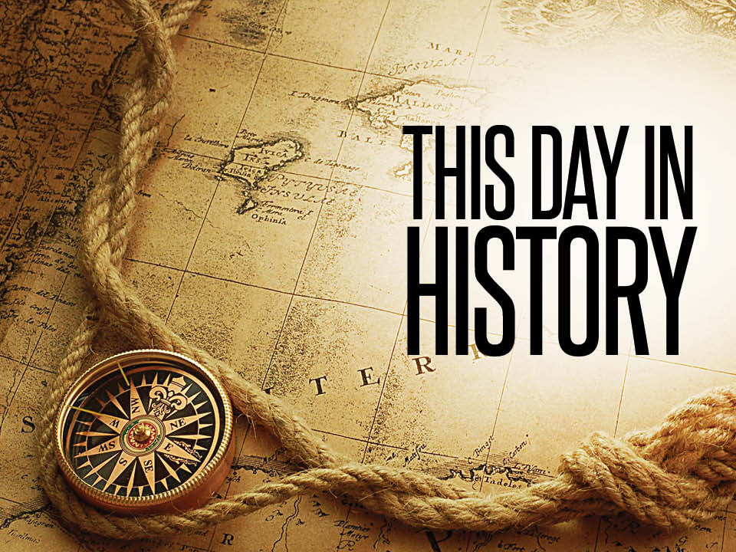
On this day
Teacher: Chris Lappin
Student: Santiago Azalde
Grade: 2nd of secondary
Date: Wednesday 2nd November

Slide 2
What happened today?

Slide 3
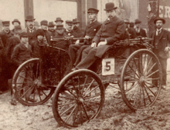
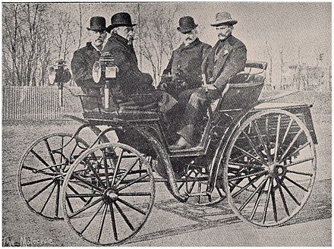
Some information
It was won by Frank Duryea’s.
The race generated considerable publicity for the motorcycle, which had been introduced to the United States only two years earlier.
On July 10, 1895, the Chicago Times-Herald announced a race to be held in the city, prizes totaling $5,000.
Eighty-three cars were initially entered in the race, but only six made it to the actual competition. Many of the entrants did not finish their cars on time and several were unable to make the trip.

Slide 4
