Slide 1
FREDDY
MERCURY
Student: Sebastian Tapia Barreno
Teacher: Vladimir Solano
Date: Friday 24th of November 2023
Grade: Second “A”
PRESENTATION OF TODAYS THE DAY

Slide 2
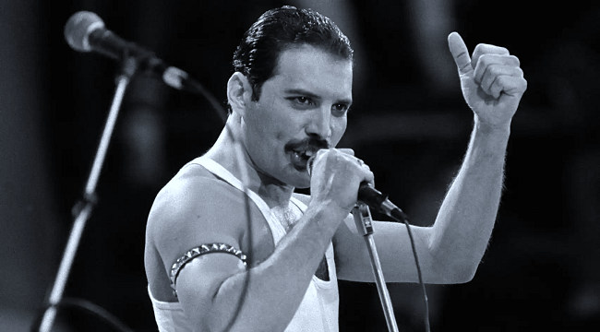
THE DEATH OF FREDDY MERCURY
Today I am going to talk about of Freddy Mercury, he’s was born in 1991 exactly the 24 of November, First, I would like to explain that Freddy Mercury was a famous Singer who composed several songs. Next I want to menrion some of his most famous songs, which are “Bohemian Rhapsody” and “We are the Champions”. Finally, I want to conclude by saying that Freddy Nercury died from bronchopneumonia resulting from VIH.

