Slide 1
Student: Rodrigo Sánchez Teacher: Chris Lappin Date: Wednesday 16th (Sixteenth) November 2022

Slide 2
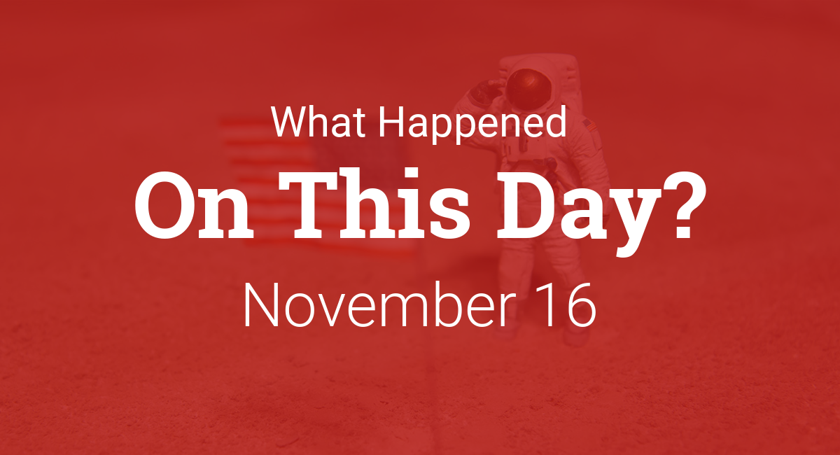

Slide 3
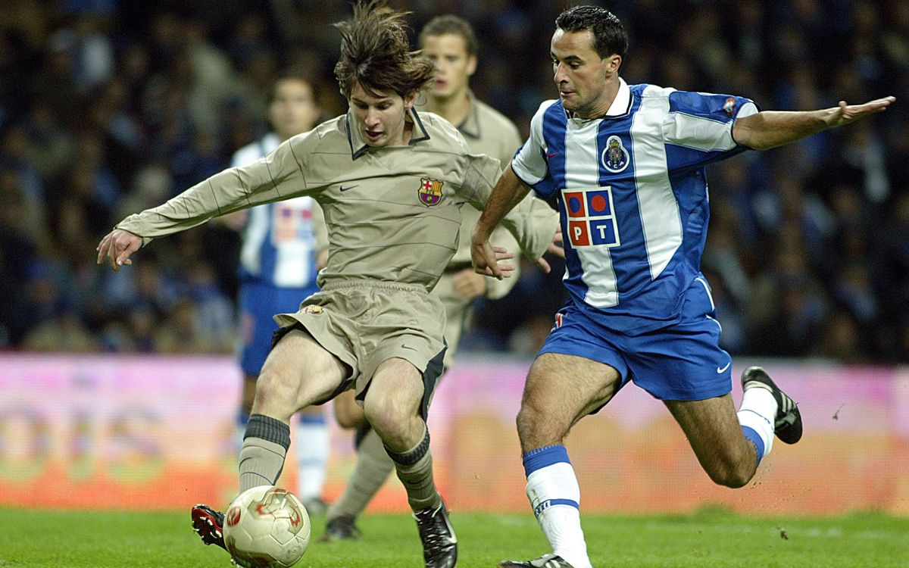
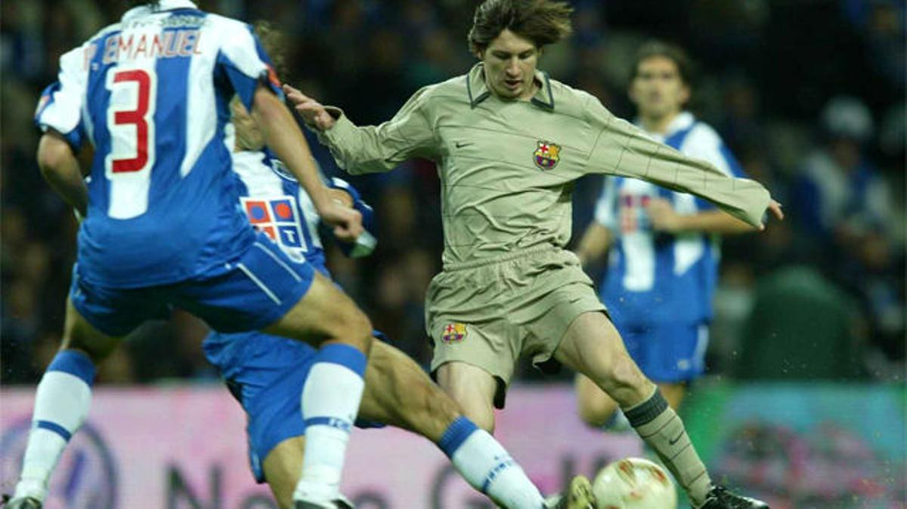
MESSI’S OFFICIAL DEBUT FOR BARCELONA AGAINST JOSÉ MOURINHO’S PORTO.

Slide 4
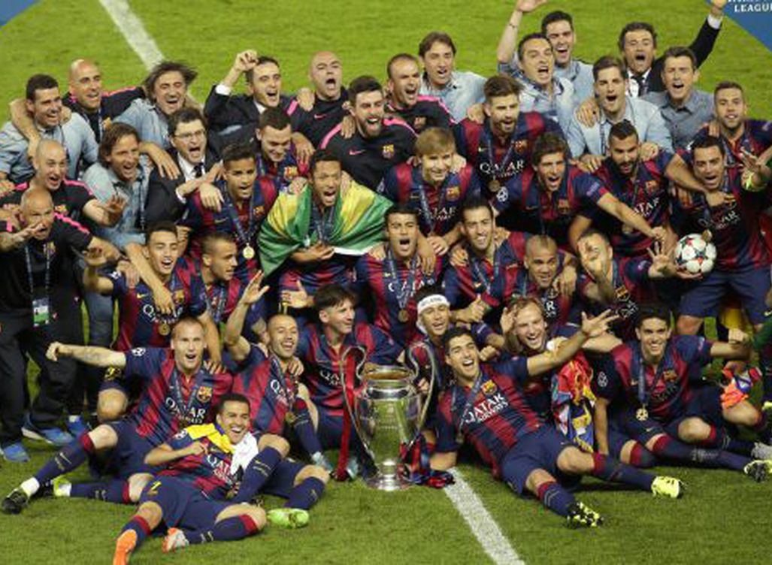
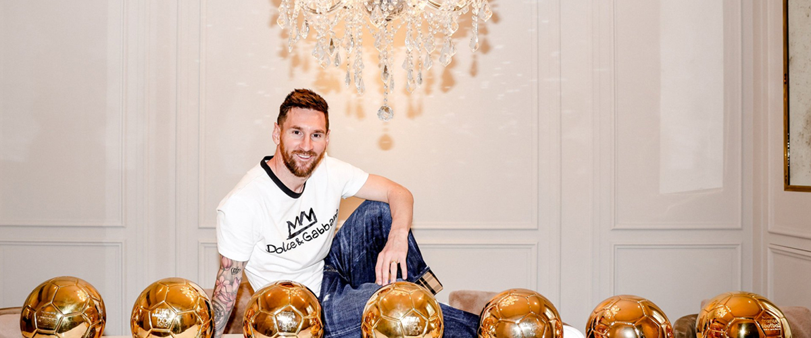
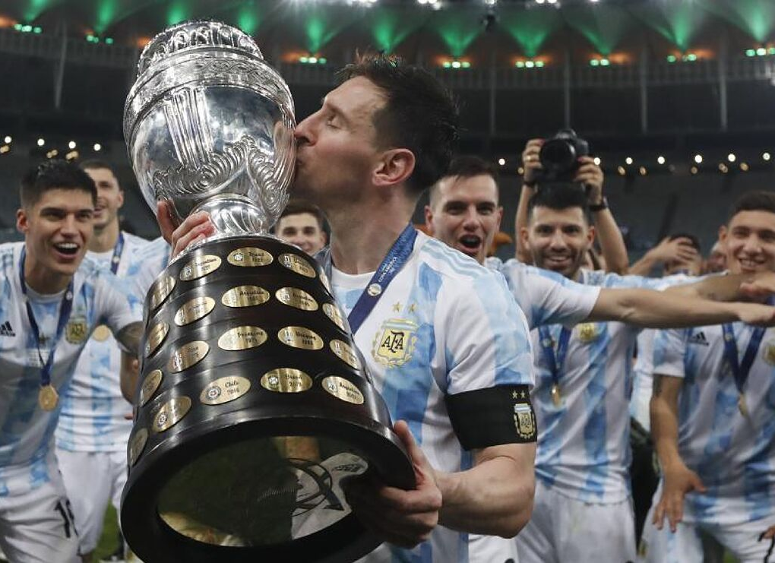
Messi’s prizes and achievements

Slide 5
Messi’s goals and skills

Slide 6
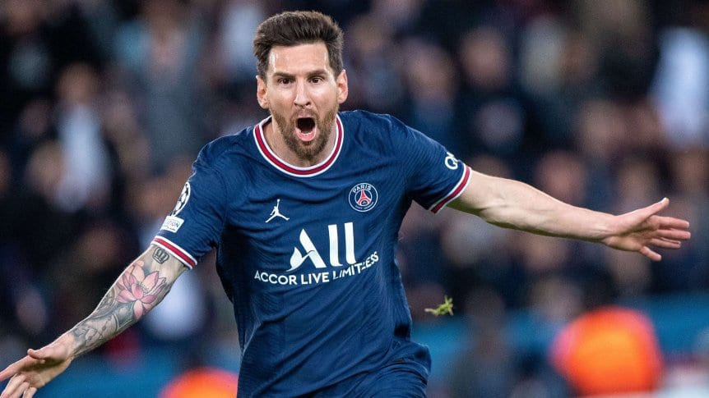
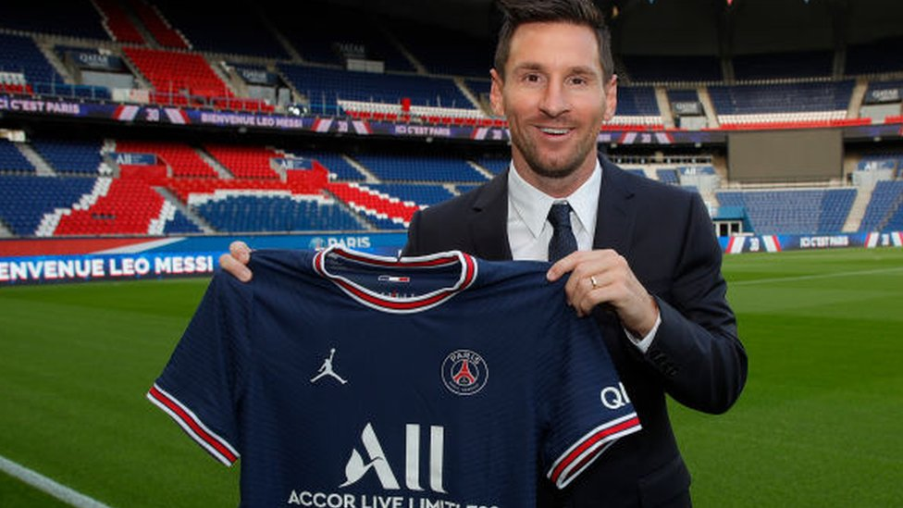
Messi today

Slide 7
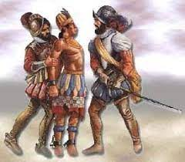
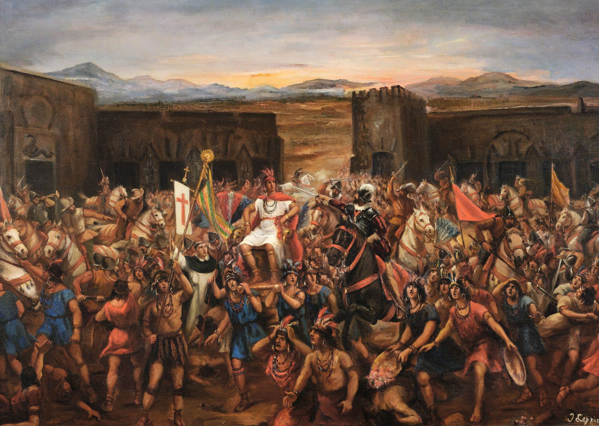
Capture of Atahualpa

