Slide 1
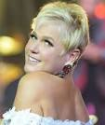
Good afternoon everyone. Today I am going to talk about the birth of xuxa. First I would like to explain xuxa’s job. She worked in Brazilian television presenter, singer and actress. Next, I want to mention, she is also known as the queen of the shorties. She worked 27 years at glove tv and built a net worth of over $500 million dollars.
Thanks for listening.

