Slide 1
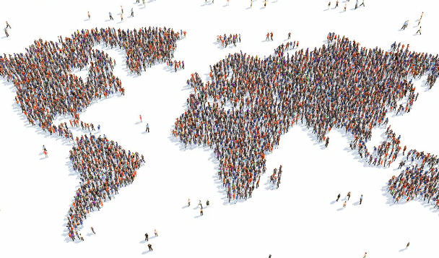
World Population day
Joaquin andres
rojas tejada
6to. Grado “a”
https://nationaltoday.com/world-population-day/

Slide 2
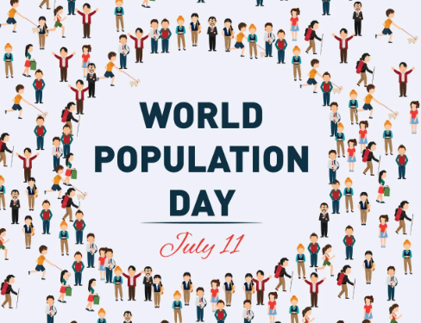
World Population day
This original date was decided to be set as ‘World Population Day’ by the United Nations General Assembly, and made this official in December 1990.

Slide 3
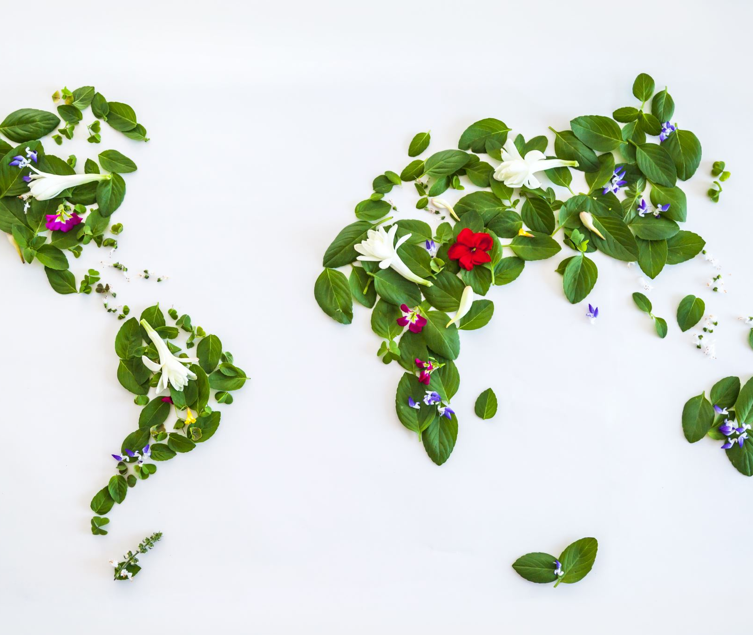
World Population Day serves to highlight the growing problems that come with a growing global population. Overpopulation is a crucial issue, especially considering that world resources are unsustainable.
The increasing population also impact on health problems faced by women during pregnancy and childbirth, making the need for family planning, gender equality, and maternal health more important than ever.

Slide 4
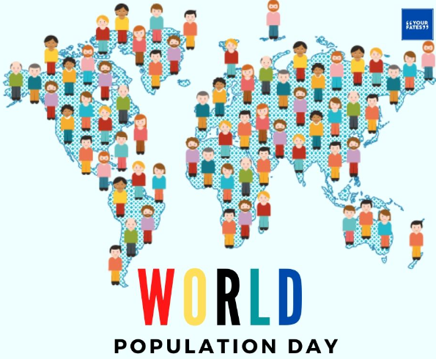
TRADITIONS
This event is celebrated in various countries around the world by seminars and public discussions, virtual or at conferences.
Educational sessions and workshops are also held by institutions.
Slogans and banners are distributed and people post about it on social media.

Slide 5
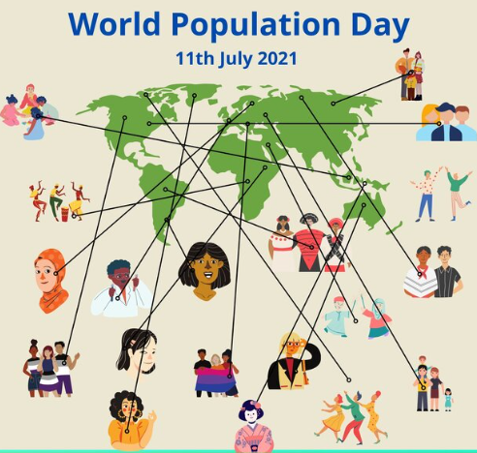
WHY WORLD POPULATION DAY IS IMPORTANT
It touches everyone
The more people are added to the population, the more power and food is needed to sustain all of them. Efforts contributing climate change, affects you no matter where you live.
2. It asks us to look forward
Reminds us to look at the current population and population of the future, and what efforts it will take to slow population growth.
3. There’s a big disparity in how population issues affect different countries
Population issues affect different, people in developing countries have a life expectancy that’s about 20 years shorter than people in developed countries.
World Population Day is a good reminder to step outside ourselves and focus on these important issues.

Slide 6
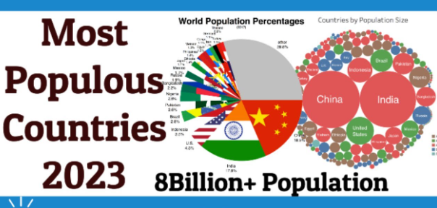
Thank you
https://nationaltoday.com/world-population-day/

