Slide 1
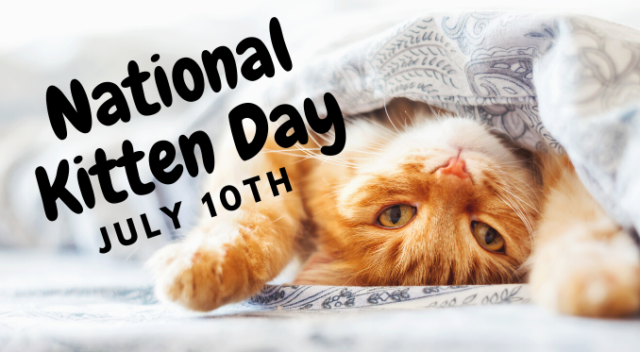
GOOD MORNING TEACHER AND CLASSMATES

Slide 2
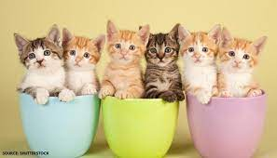
This date is July 10th and celebrate national kitten day today is important because on this day people help cats are on streets and because they receive special treatment on this day. The celebration was created by animal advocate and pet expert Collen Paige The day was created in tribute to Socks kitty of former president of the United States Bill Clingtong.

Slide 3
THANK YOU FOR LISTENING

