Slide 1
NATIONAL FOREST WEEK
6TH NOVEMBER
BY: SAIHAJ SINGH LAURE

Slide 2
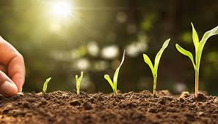
What is commemorated today?
The first week of November serves to generate reflection on the current situation of our environment.
This date is established by Ministerial resolution, with the objective of
raise awareness among the population and promote re-vegetation and tree planting actions for diverse such as soil conservation, productive use (wood, resins, fruits, etc.), landscape improvement or climate change mitigation.

Slide 3

What does the National Forest Action consist of?
FIRST, the forests are essential for life, they work 24 hours a day extracting dioxide of carbon from the air in order to provide us with the oxygen we need to live.
ALSO, they provide various benefits at the local, national and even global; since they regulate water levels, improve the environment, fertilize the soil, they generate various products that area source of food and work, and being an element vital in communities, they help preserve their culture and traditions.
NEXT, Peru has been joining the efforts in the world for sustainable use of our forest resources, and under the main objective of reforestation, because recovering forests is crucial to the problem of climate change. Civil organizations, municipalities, Police or Regional Governments must intensify their security policies protection by carrying out more operations to stop illegal logging, generating strategies for prevention or declaring and promoting large forest areas as nature reserves protected

Slide 4
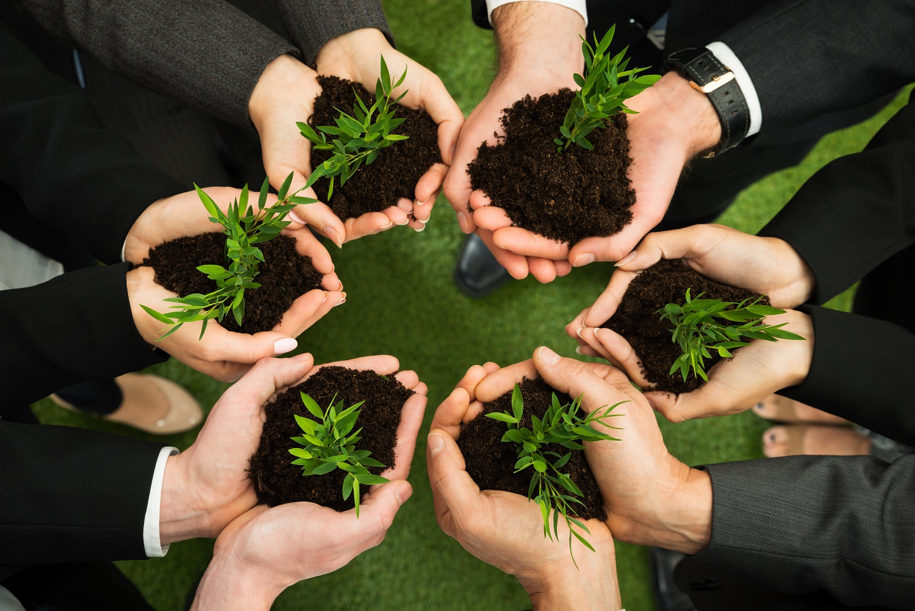
Why is it important to celebrate this date?
FINALLY, Our country has more than 60 percent of the national territory of forested area, which It forms large natural stores of food, medicine, clean air, housing, timber and non-timber products. Therefore, it can be said that Peru is a country forestry, its 73.3 million hectares of forest place it in 9° place in the world with the largest forested area and the 2° in South America.
However, our territory has been harmed by the improper exploitation of resources, which as a consequence left many deforested areas, affecting the ecosystem and its communities.
«That is why we have in our hands a great responsibility for protection and recovery of our forest wealth. This must be translated into concrete actions that involve all Peruvians and for this it is necessary that we be aware of the environmental Issues».

