Slide 1
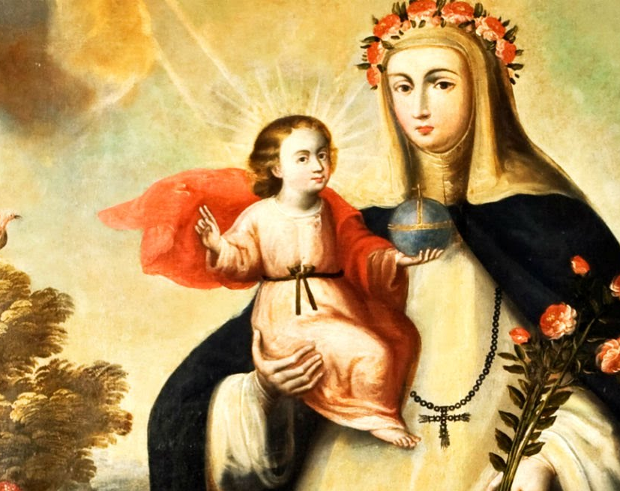
Santa Rosa de Lima
20th April 1586

Slide 2
St.Rose of Lima, Spanish Santa Rosa de Lima, original name Isabel Flores de Lima, was born on April 20, 1586, Lima-Peru. She was the first person born in the Western Hemispehere to be canonized by the roman Catholic Church. She is the patron saint of peru and all of South America as well as of embroiderers, gardeners, and florists. She was skilled in needlework and sol her fine lace and embroidery and the flowers that she grew in her garden to help her family and to raise funds for the poor.

