Slide 1
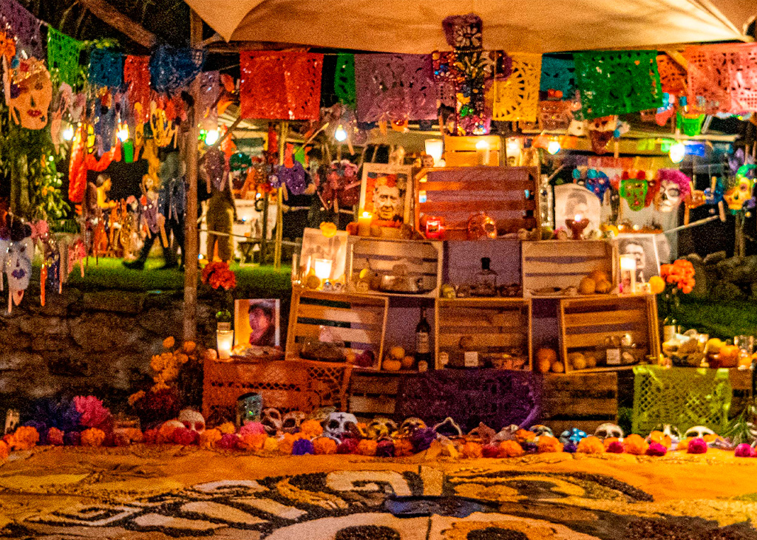
THE DAY OF THE DEAD
Name: Juan Renato Tello Espejo
Teacher: Solano Gonzales, Vladimir
Date:Thursday the 02th of November, 2023

Slide 2
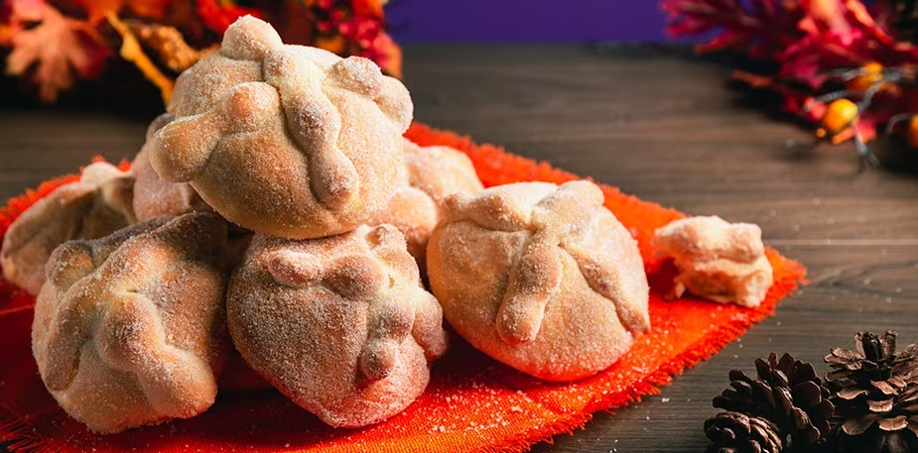
What is the typical food for the Day of the Dead?
Bread of the Dead.
Fruit.
Tamales.
Sweets.
Sugar skulls.
Mass.
Atole.

Slide 3
Conclusion:
The Day of the Dead is a joyful celebration that celebrates the lives of those who have died rather than mourning their departure that showcases the rich culture, traditions and beliefs of Mexico, and has been recognized by UNESCO as Intangible Cultural Heritage of The humanity.

