Slide 1
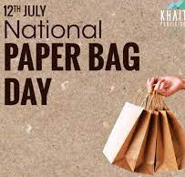
Paper Bag Day
Made by: JOAQUIN NICOLAS CUYO UCAÑAY
Classroom: 6th grade B
Teacher: Andres Torres
Date: Wednesday, July 12, 2023

Slide 2
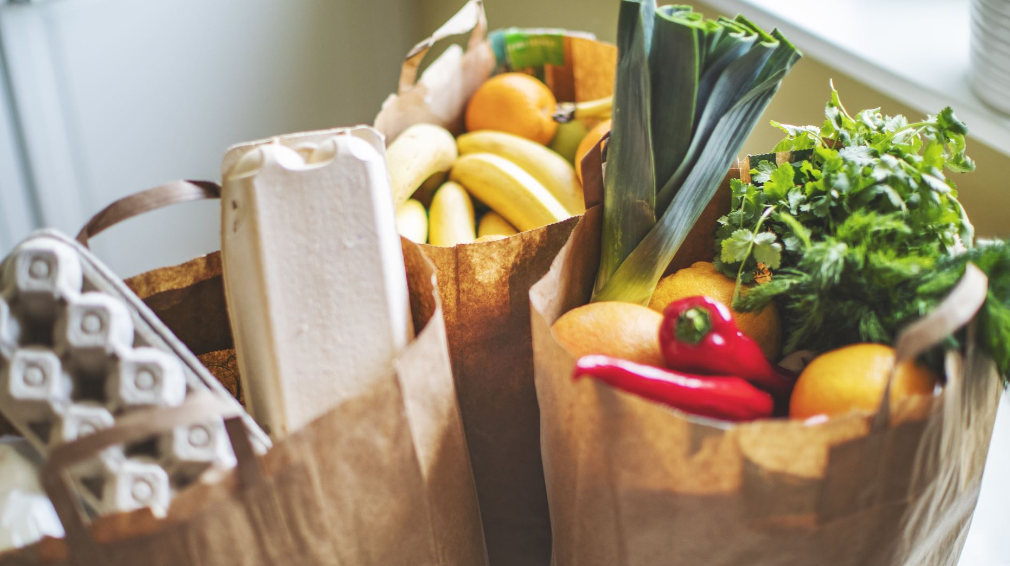
What is National Paper Bag Day?
Paper Bag Day (also known as World Paper Bag Day) occurs on July 12 each year and celebrates the humble paper bag, which does so much more than carrying our groceries.
Paper is biodegradable, which immediately makes it a preferable alternative to plastic.
Paper bags are also made of renewable raw materials, which encourage a sustainable lifestyle, as they can be recycled.
Paper bags can be quite durable, and they now have a more upmarket aesthetic appeal thanks to high-end brands popularizing minimal and sustainable packaging.

