Slide 1
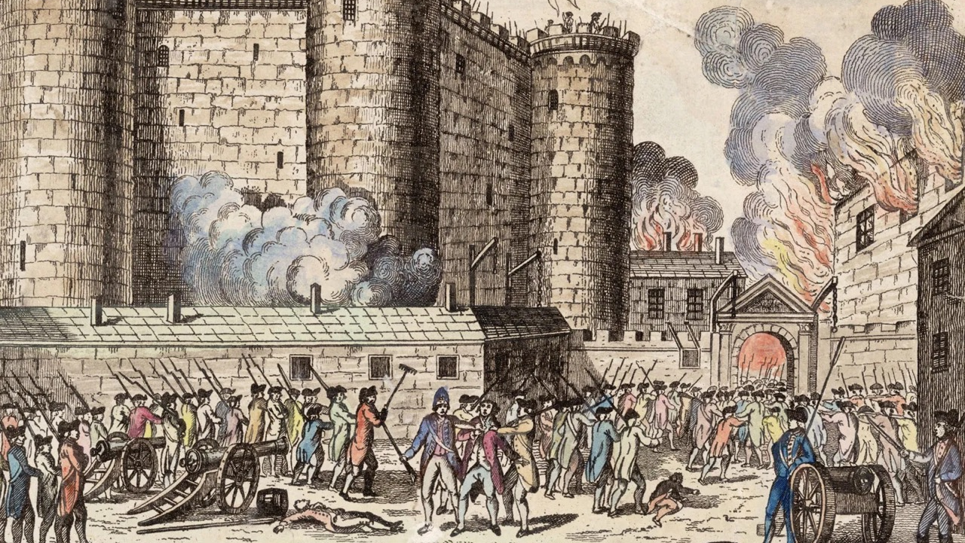
Imprisonment of Louis XVI of France
Bryan Zapata Urbina

Slide 2
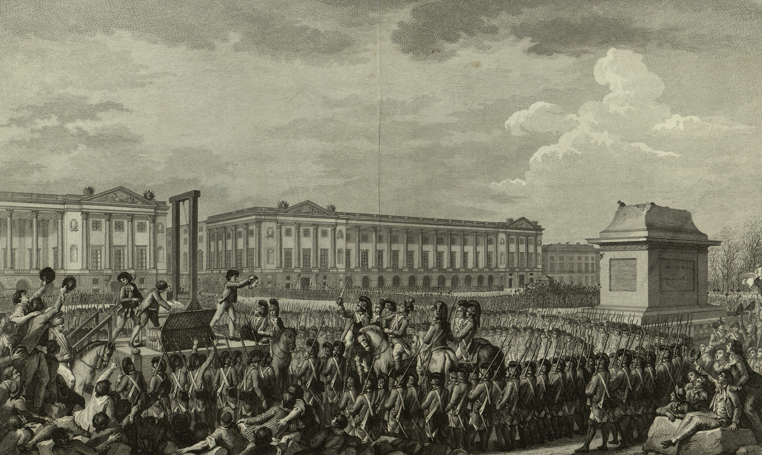
The day of August 10, 1792, during the French Revolution, which put an end to the monarchy of Louis XVI, which is why it is also known as the second revolution. The main event was the assault on the Tuileries Palace by the insurgents, members of the Paris sections, together with the federated troops. The king sought the protection of the Legislative Assembly, but was suspended from his constitutional duties and detained along with his family. At the same time it was decided to call elections by universal suffrage to form a National Convention that would assume all the powers of the State and draft a new Constitution. After Louis XVI was put on trial and sentenced to death, he was finally guillotined in January 1793.

