Slide 1
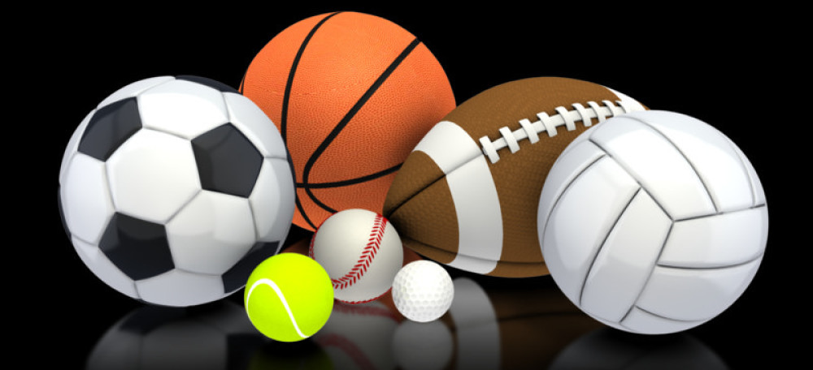
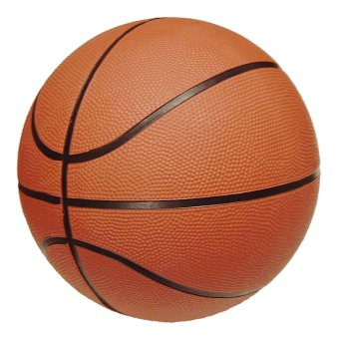
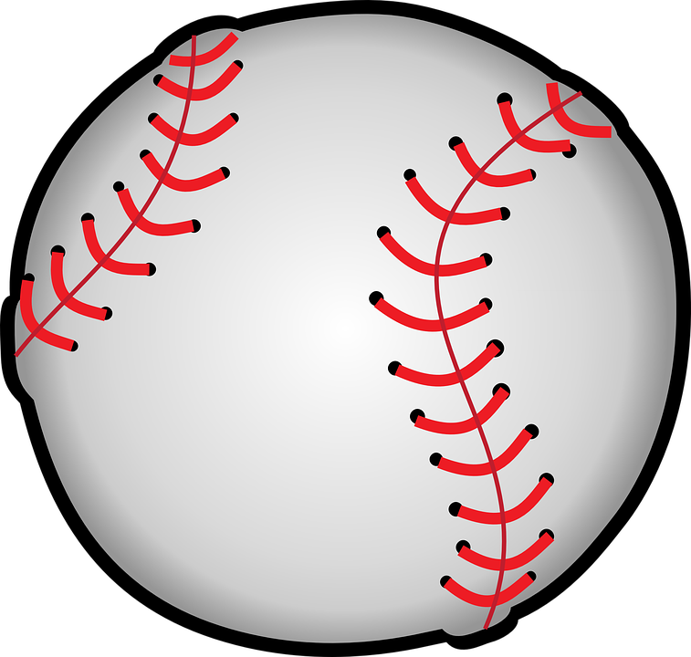
National Sports Day
Student: Diego Guerrero
Teacher: Andrés Torres
Grado y Sección: 6to “B”

Slide 2
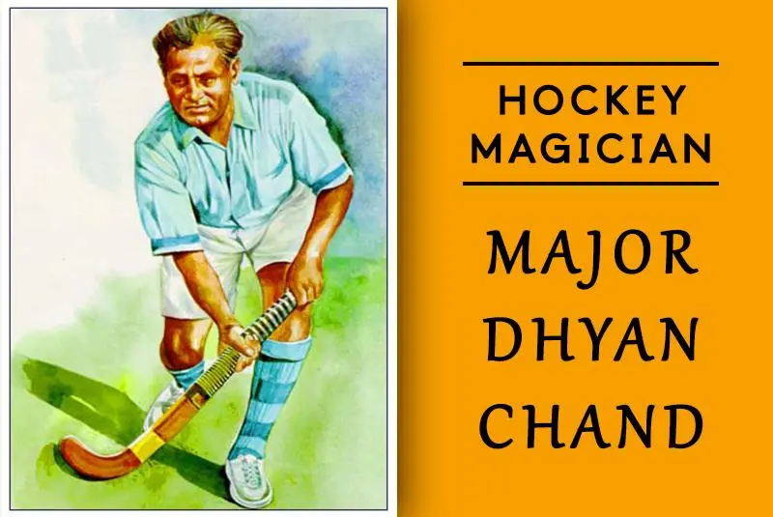
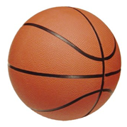
India celebrates National Sports Day on August 29, the birth anniversary of hockey hero Major Dhyan Chand. In 2012.
The day was declared India’s National Sports Day.
Major Dhyan Chand was a legend in Indian and international hockey. With victories at the Summer Olympics in 1928, 1932, and 1936.

Slide 3
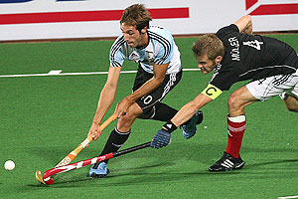
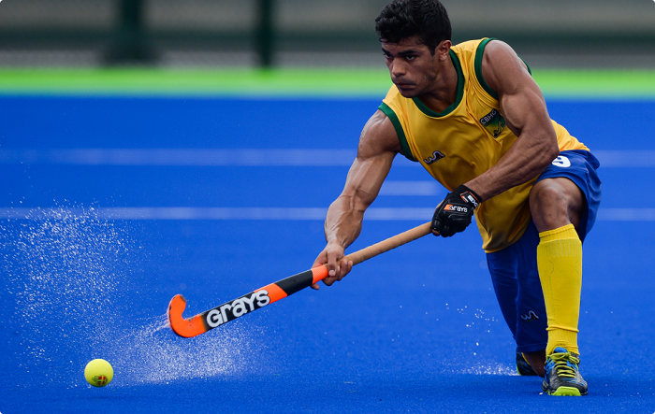
He was instrumental in helping India complete their first hat-trick of Olympic gold medals. Dhyan was so dedicated to his art that he used to practice hockey at night after his regular daytime tasks were over, earning him the nickname Dhyan ‘Chand.’
National Sports Day is a public holiday celebrated in various countries. On this day people take a part in sports like marathon,basketball, hockey.

Slide 4
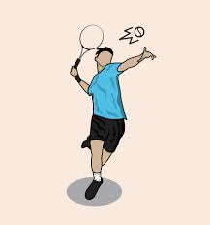
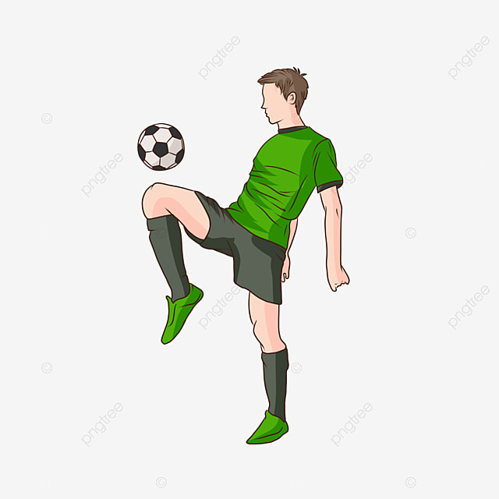
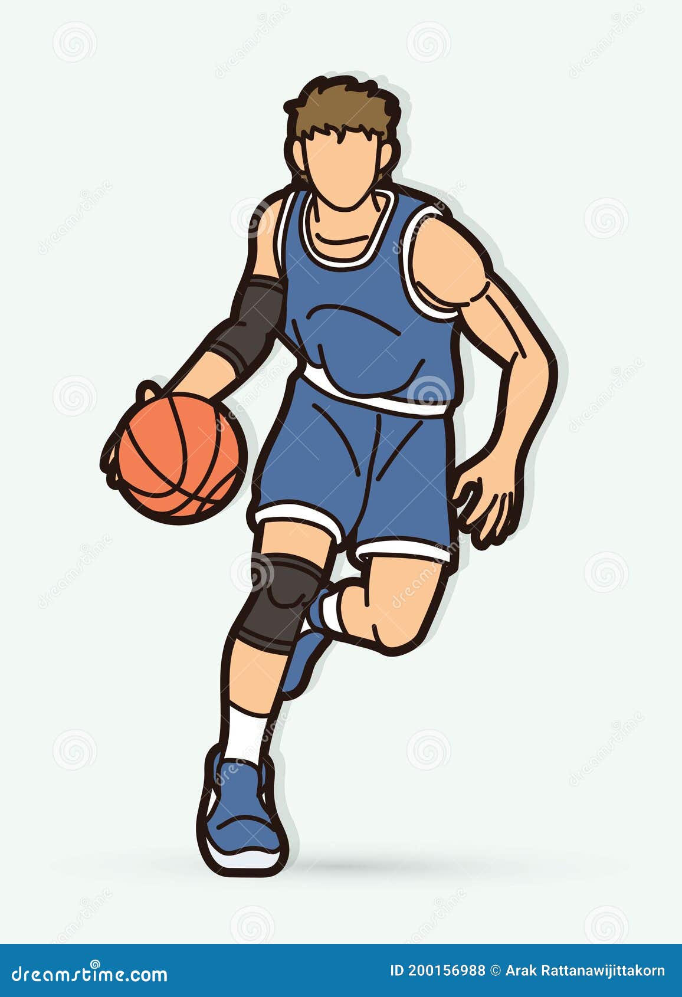
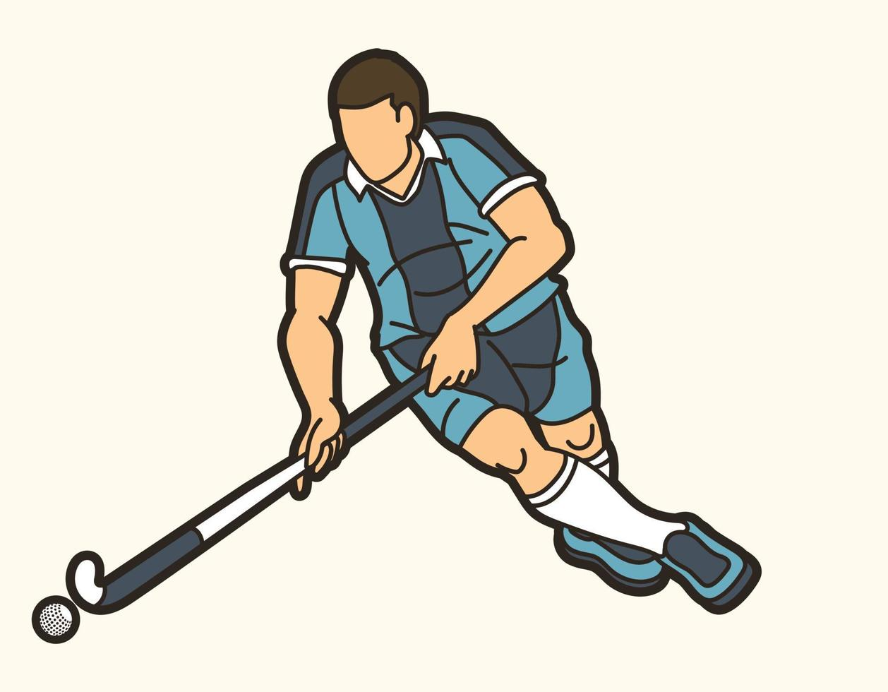
THANKS

