Slide 1
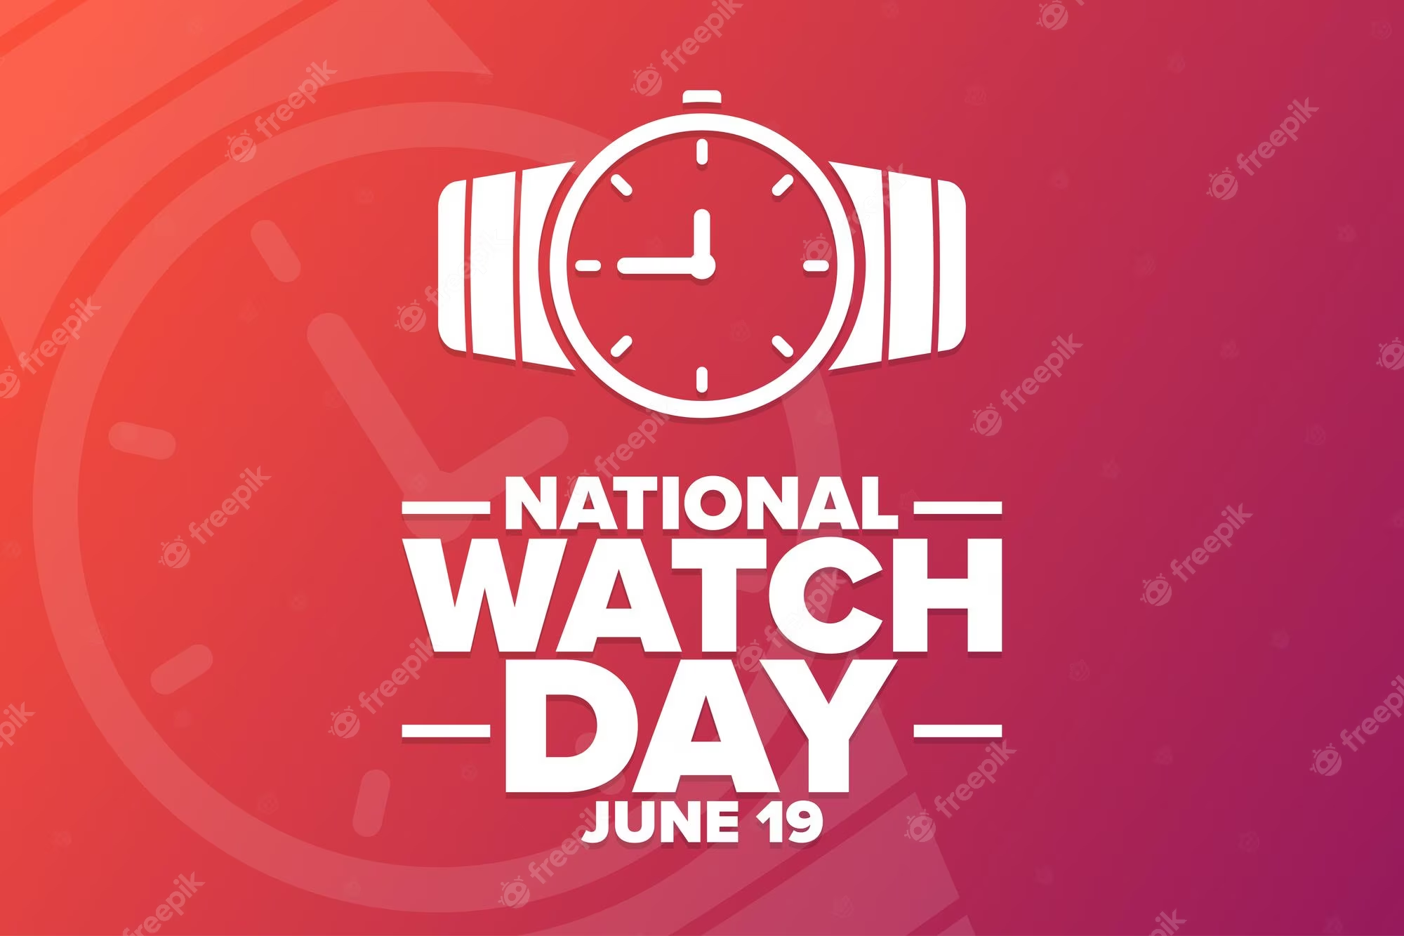
THE NATIONAL WHATCH DAY
DO : DANCK ACUÑA MARTINÉZ
ISSUE : THE NATIONAL WHATCH DAY
COURSE : ENGLISH

Slide 2
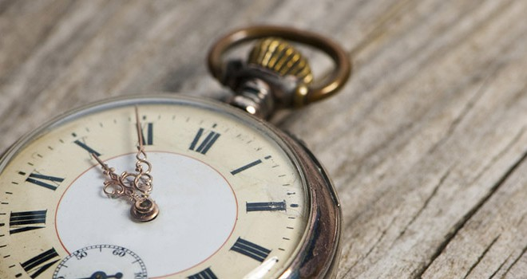
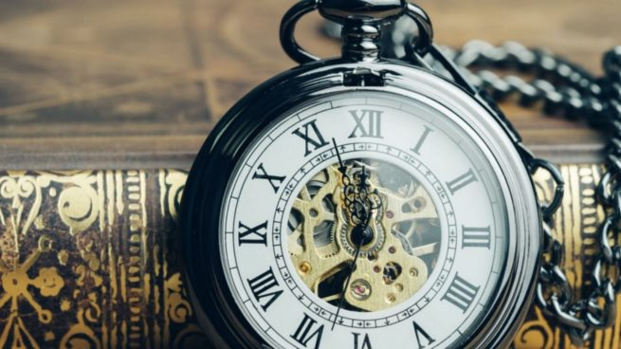
GOOD MORNING TEACHER AND CLASSMATES
TODAY I AM TALKING TO THE NATIONAL WHATCH DAY
TODAY IS 19 TH AND THE AMERICANS CELE BRATED THE NATIONAL WHATCH DAY

Slide 3
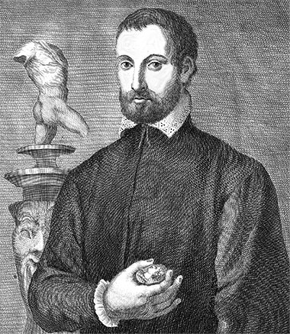
The date is important becouse…
The people we renember the birht of the italian Benvenutto Cellini
Its is also important because is helps us to see the time
It is due to the commemoration of one of the most outstading goldmiths of the italian reanissence : Benvennutto Cellini

