Slide 1
World Day Against Colon Cancer
PRESENTATION OF ENGLISH
Student’s Name: Justo David Pedraza Esquerre
Grade and section: 1st A
Teacher’s Name: Vladimir Solano Gonzales

Slide 2
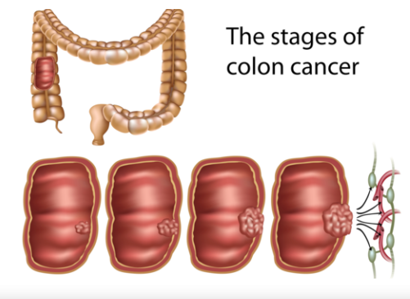
World Day Against Colon Cancer
Today I am going to talk about the world day Against Colon Cancer.
First, I would like to explain that the colon cancer is a disease that causes genetic changes.
Next, I want to mention that the colon cancer can be cured if detected early.
Finally, I will conclude by saying that colon cancer can cause a million deaths a year.

Slide 3
Thank you for listening!

