Slide 1
Today is The Day: The Grandfathers day
Student: Juan Diego Valencia Cotrina

Slide 2
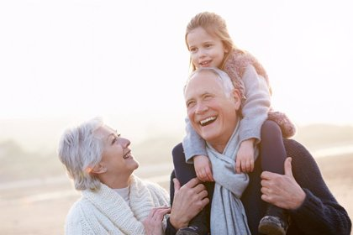
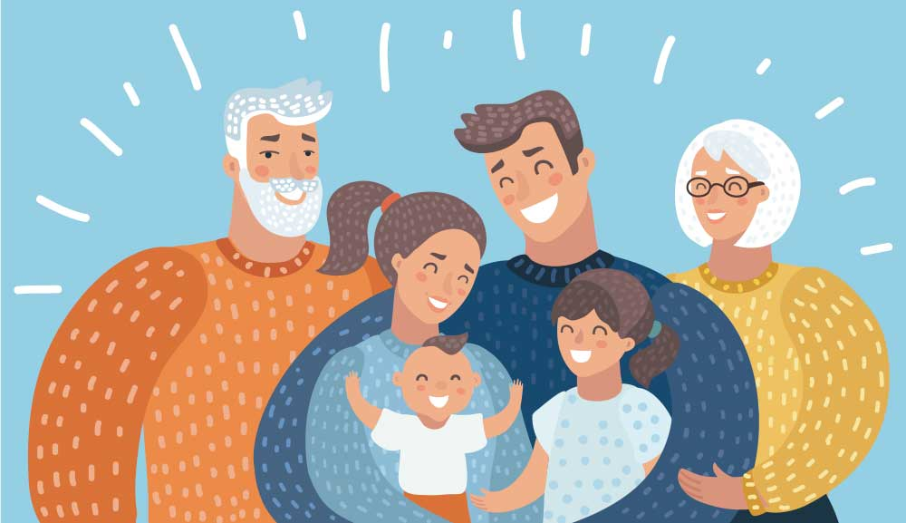
What are grandparents and what is their job in the family?
As traditional figures in children's lives, grandparents are often seen as the strong and dedicated caretakers of the family unit. For this reason, the role played by grandparents is decisive in moments of family adversity and they appear to help the whole family to overcome a crisis.
They transmit wisdom, tranquility, affection, stability and many other necessary values ​​in life.

