Slide 1
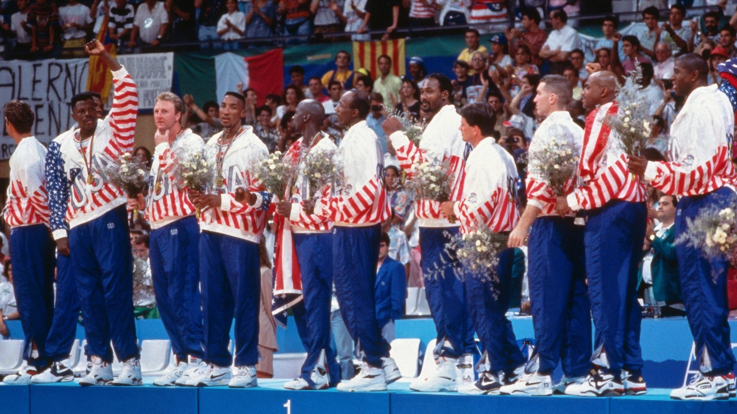

Slide 2
Good Morning Teacher and Classmates Today I will to talk about: “The Dream Team Nickname”, to start in the year 1992, the NBA of the United States, qualified for a cup that was played in Barcelona, Spain, for which they hired world-class players to the tournament, most countries were afraid of the American team becasue, there were 3 very important players on their team, they are: Michael Jordan, Magic Johnson and Larry Bird, this team was able to defeat their rivals such as Spain, Angola, Brazil, Lithuania, etc. Then American team would go to the final, their rival was the Croatian Team, which also came from winning the matches, in this final the American´s won the final. To finally the NBA nicknamed them as: “Dream Team”.

