Slide 1
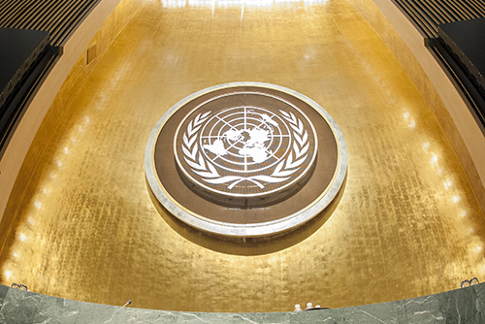
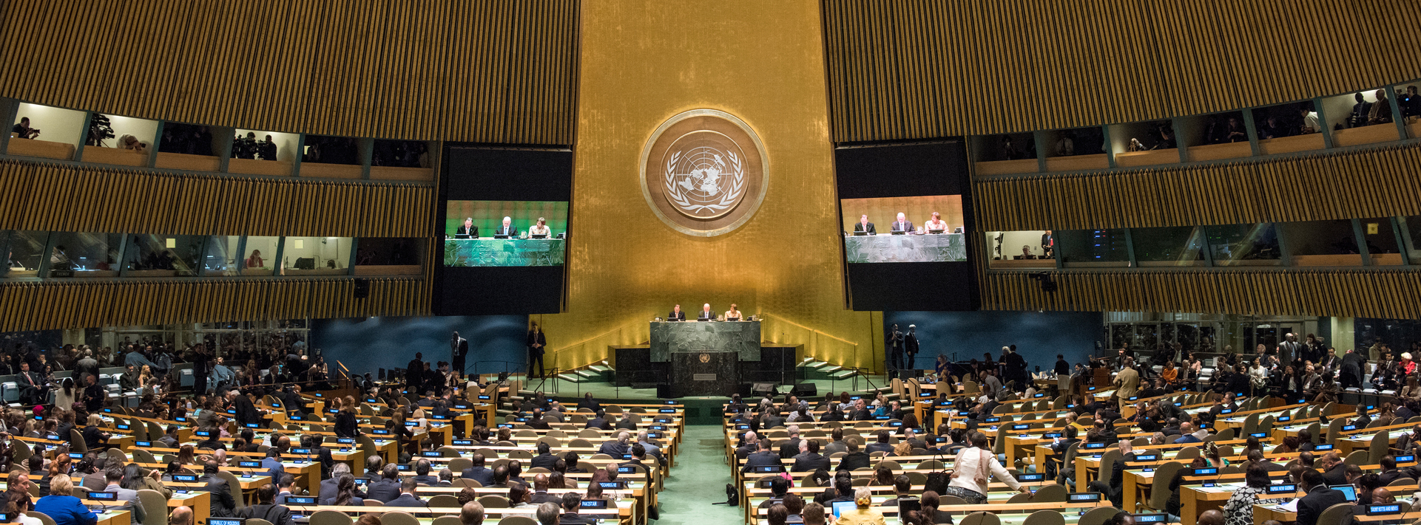
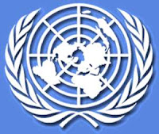
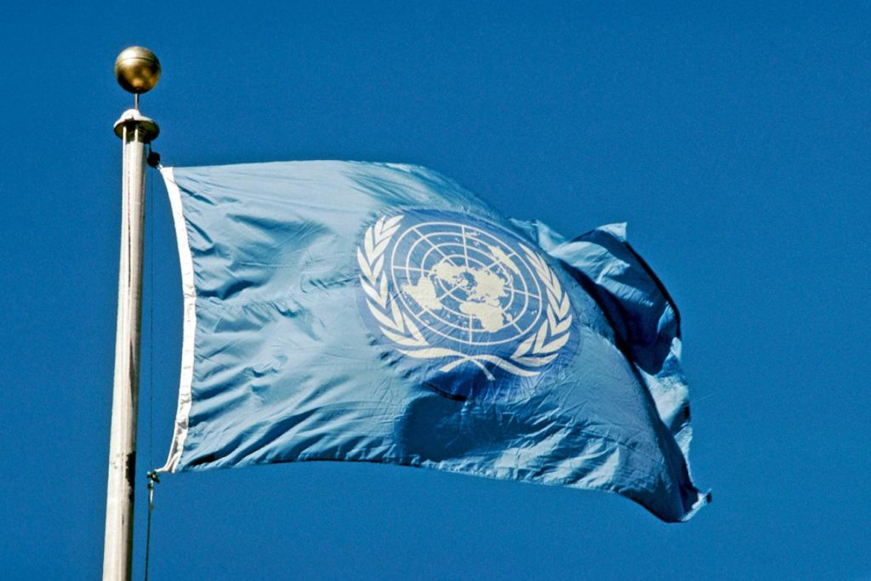
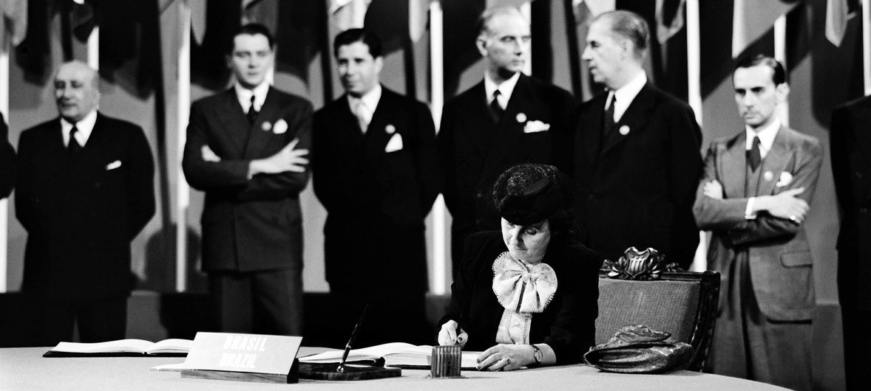
Creation of the United Nations
Today is the day 24th of October

Slide 2
Good morning, today I am going to talk to you about The United Nations, it was officially born on October 24, 1945, first I would like to explain to you that this union arose after the majority of the 51 member states that signed the founding document of the Organization, The Charter of the United Nations, next I want to mention that there are currently 193 Member States of the United Nations, which are represented in the deliberative body, the General Assembly. Finally I will conclude by saying that the United Nations is the only place on Earth where all the nations of the world can meet, discuss common problems and find shared solutions that benefit all humanity.

