Slide 1
A Day Like Today
Name: Ales Junior De La Cruz Vega
Curse: Inglish
Date: Today Thursday 30th march of 2023

Slide 2
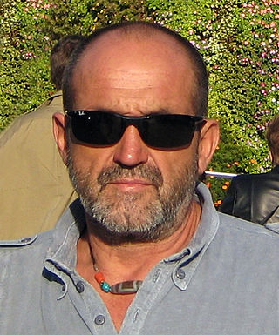
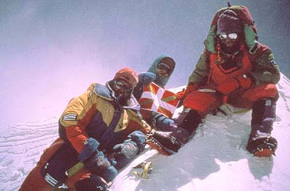
The alpinist
Well, today I am going to talk about Juan Eusebio Oiarzabal Urteaga, better known simply as Juanito Oiarzabal, who was born on March 30, 1956, Victoria, Spain.

Slide 3
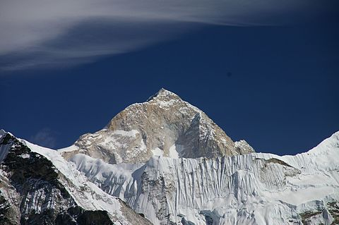
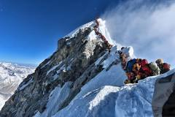
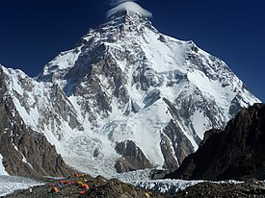
THE EIGHT-THOUSAND
First, I would like to explain that he is a professional mountaineer who has climbed 24 mountains, 10 of them exceeding 6 kilometers and the other 14 exceeding 8 kilometers, the latter being a great feat, because it makes him the sixth mountaineer to climb the mountains. "eight thousand"
Makalu-Nepal
Everest-Nepal
K2 - Pakistán

Slide 4
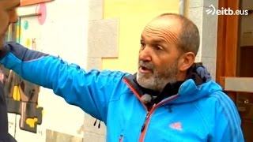
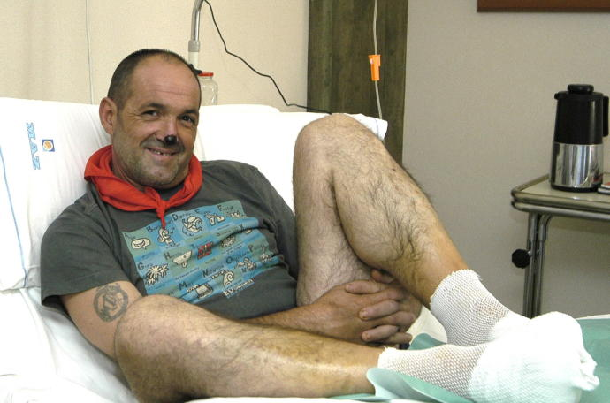
retirement
Next, I want to mention that in 2009 he wanted to be the first person to climb the "eight-thousander" mountains twice, but in May 2012 he would abandon the project, due to lack of sponsors and also due to a pulmonary adema.

Slide 5
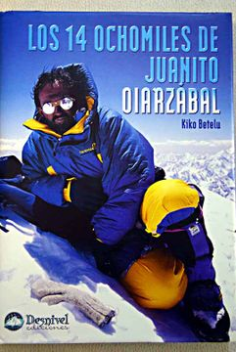
BOOKS
Finally, I conclude by saying that in his years as a mountaineer he published 7 books and one of them would be " The 14 eight-thousanders of Juanito Oiarzabal from 1999", this being the most popular book by Juanito Oiarzabal.

