Slide 1
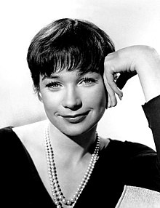
Shirley MacLaine
Good afternoon everyone.
Today i am going to talk about Shirley Maclaine.
First i would like to explain that Shirley MacLaine is an American actress, singer, dancer, writer and activist and his career has been going on for more tan 60 years.
Next. I want to mention that Shirley was born on April 24, 1934 in Richimond, Virginia, USA and she is 89 years old now and she had six Oscar nominations, winning it for best actress in the 1983 comedy-drama (Terms of Endearment) and other awards.
Finally i will conclude by saying that Shirley is one of the last living stars of classic Hollywood.

Slide 2
THANK YOU FOR LISTENING.

