Slide 1
Good Morning
Student:Josemaría Héctor Siancas Guevara
Teacher:Vladimir Solano Gonzalez

Slide 2
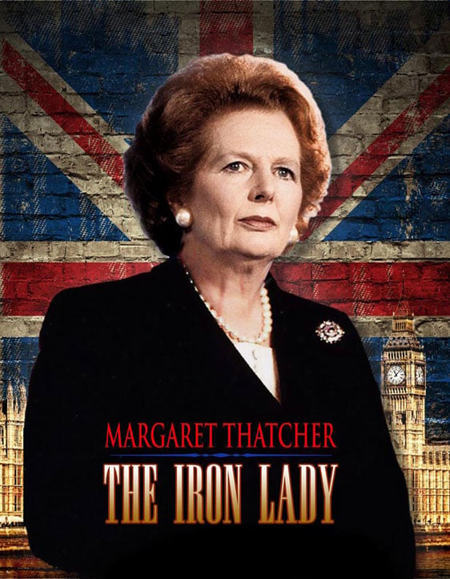
Today,I am going to talk about Margaret Thatcher
First I would like to explain who was Margaret Thatcher, she was called ¨The iron Lady¨.
-She was born in 1925 and died in 2013 in UK (United Kingdom).
-She was the first woman to hold the position of Prime Minister in Europe.
-She held this position from 1979 to 1990, becoming the person who held this position for the longest time in the 20th century.

Slide 3
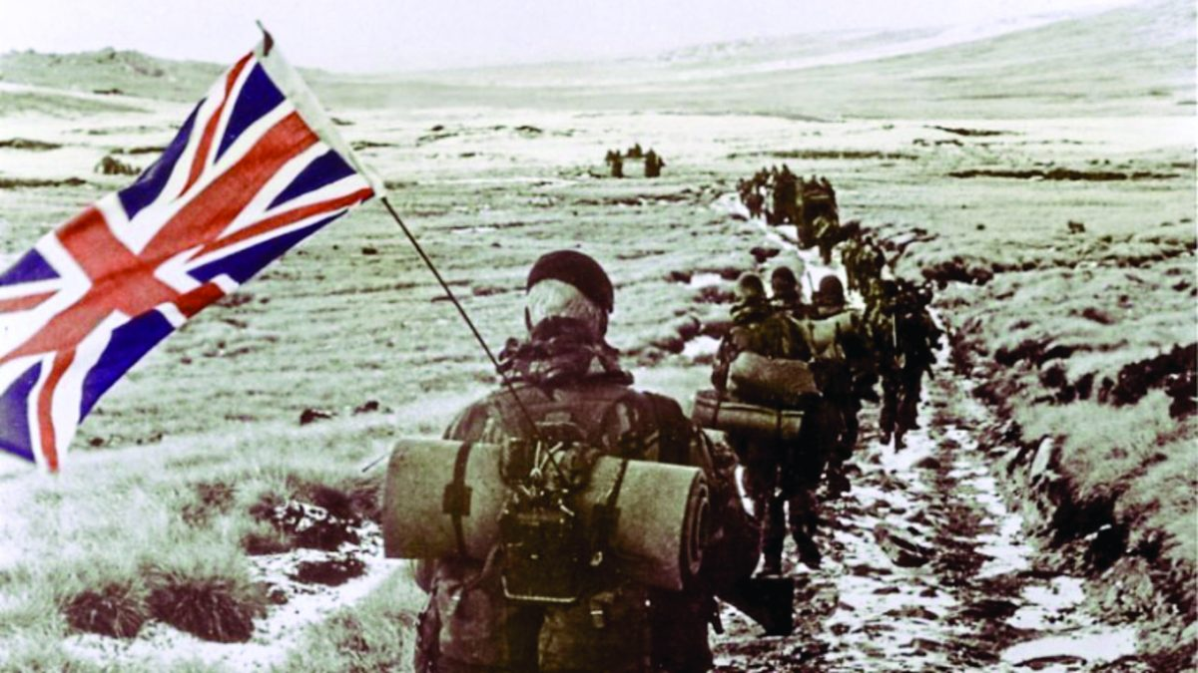
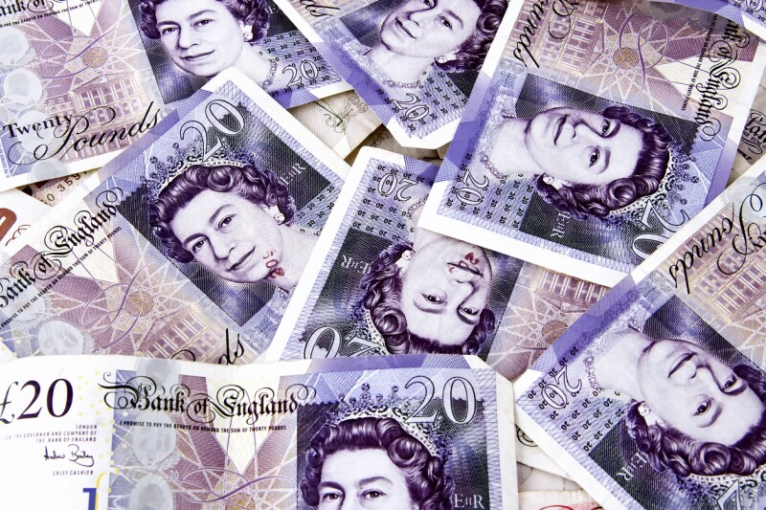
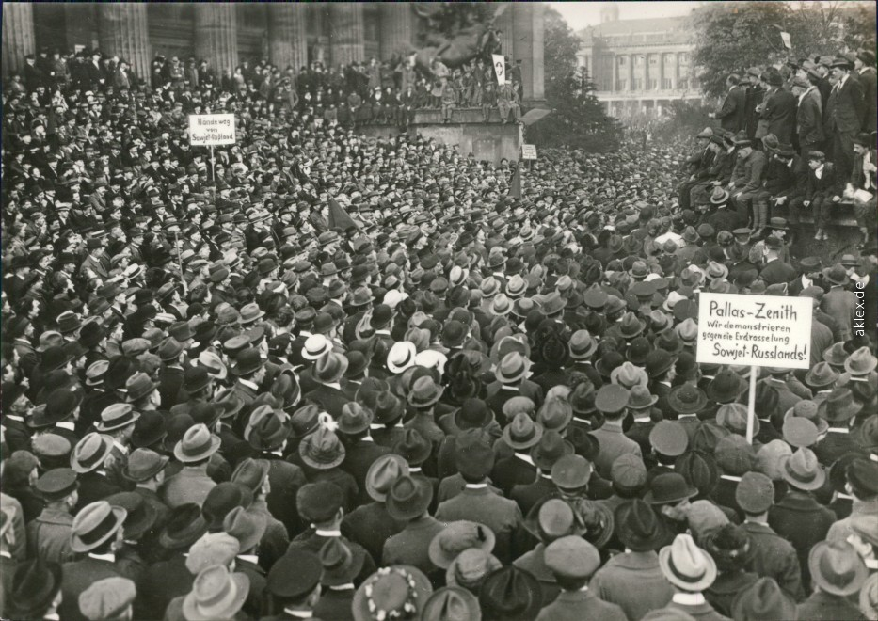
Next,I want to mention what she did in her government:
-It was possible to recover the Malvinas Islands in the war with Argentina.
-The privatization of state companies was carried out to obtain funds for the state.
-Improved the British economy.
-Reduced power of unions.

Slide 4
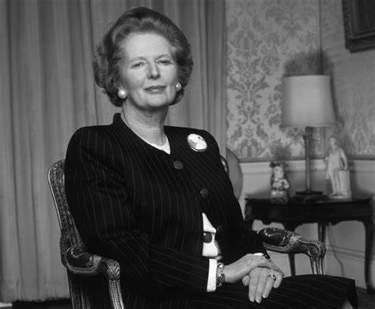
Finally,I Will conclude by saying a phrase from Thatcher:
¨In politics , If you want something said, ask a man; If you want something done, ask a woman¨.

Slide 5
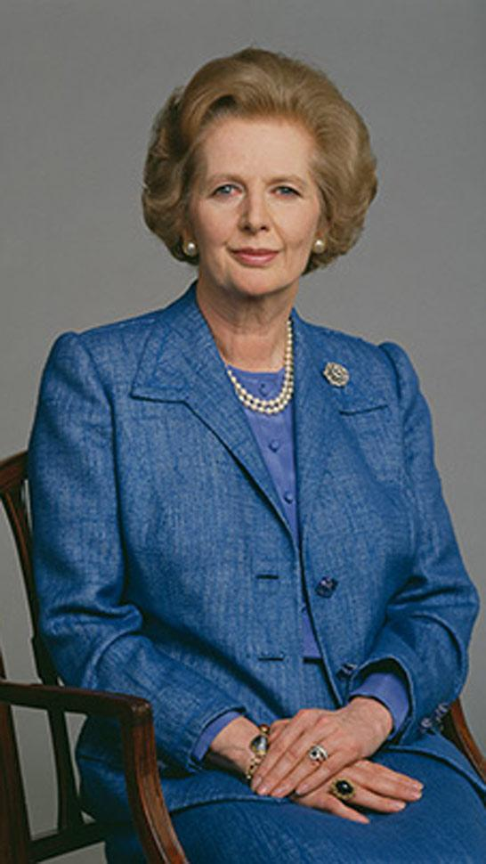
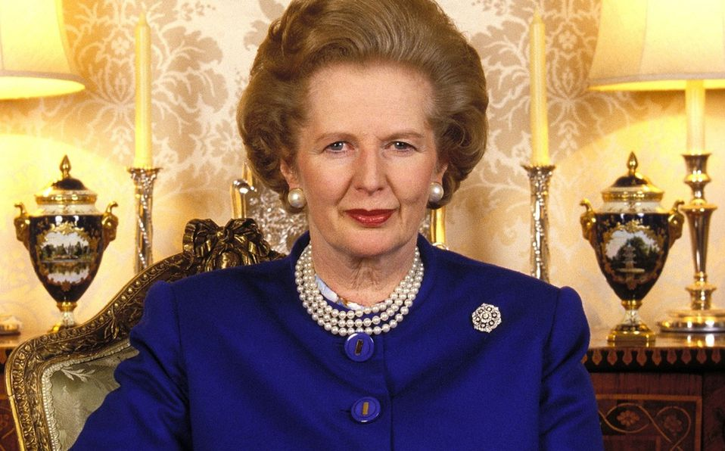
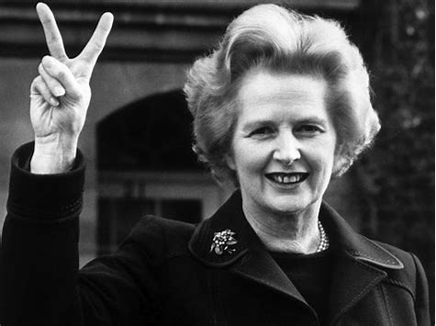
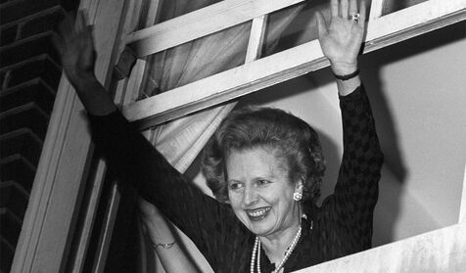
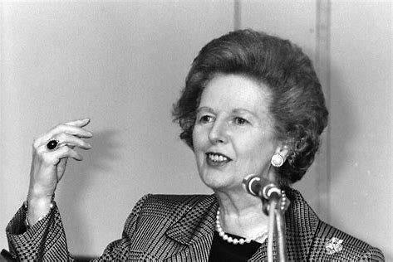
Thank for Listening my presentation

