Slide 1
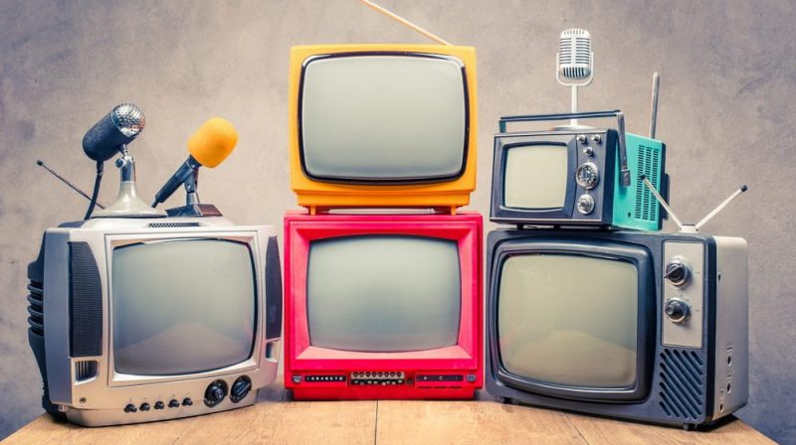
World Television Day

Slide 2
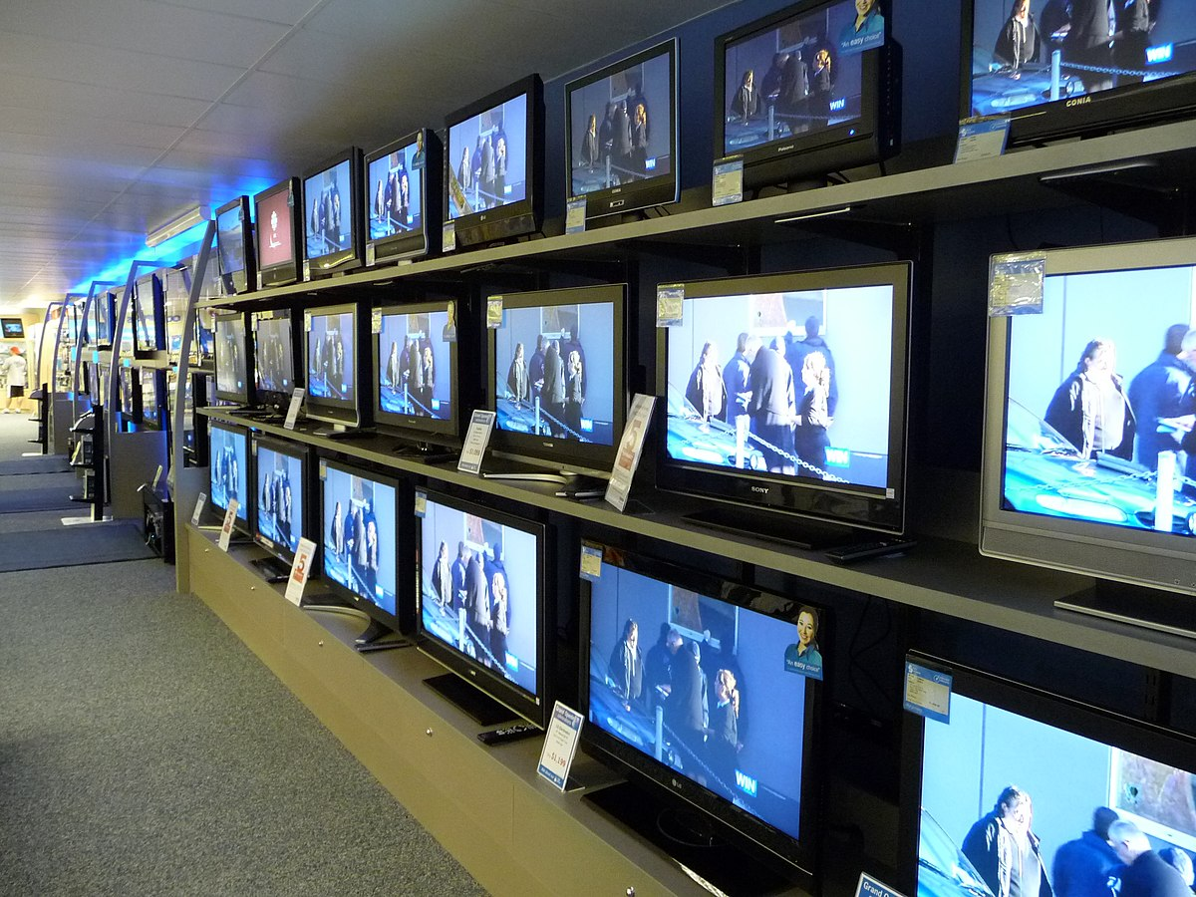
Today´s Tuesday 21 of november In 1996, the United Nations general assembly declared November 21 World Television Day; next I want to metion The first television was created on January 26, 1926 by John Logie Baird and finally; I will conclude by saying Television is a symbol of communication and globalization that educates, informs, entertains and influences our decisions and opinions.

