Slide 1

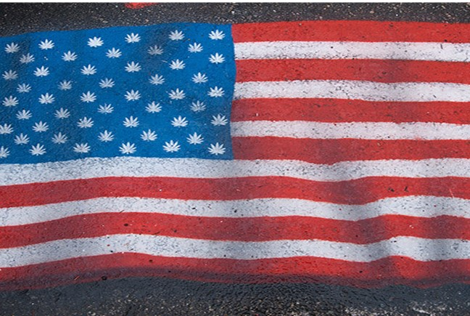
Today’s the day
06/11/2023
DOPE LEGALIZATION DAY

