Slide 1
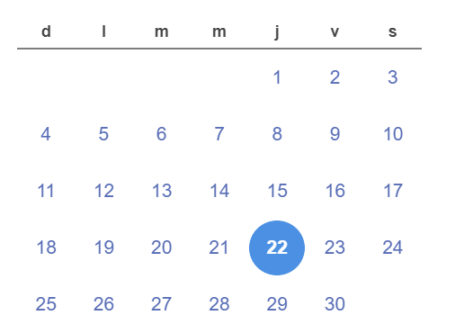
Today is the day
Date: Thursday 22nd (twenty-Second) september 2022
NAME: FRANCO PISCOYA

Slide 2
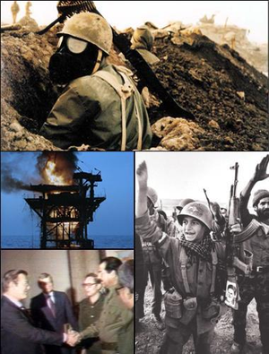
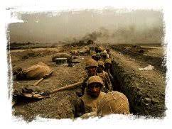
The Iraq-Iran war beggins

Slide 3
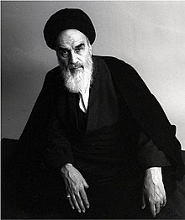
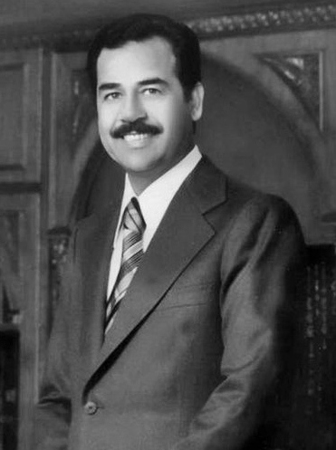
Leaders

Slide 4
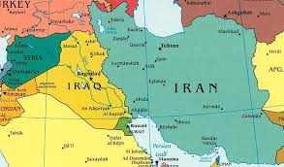
Geography

